Slide 1
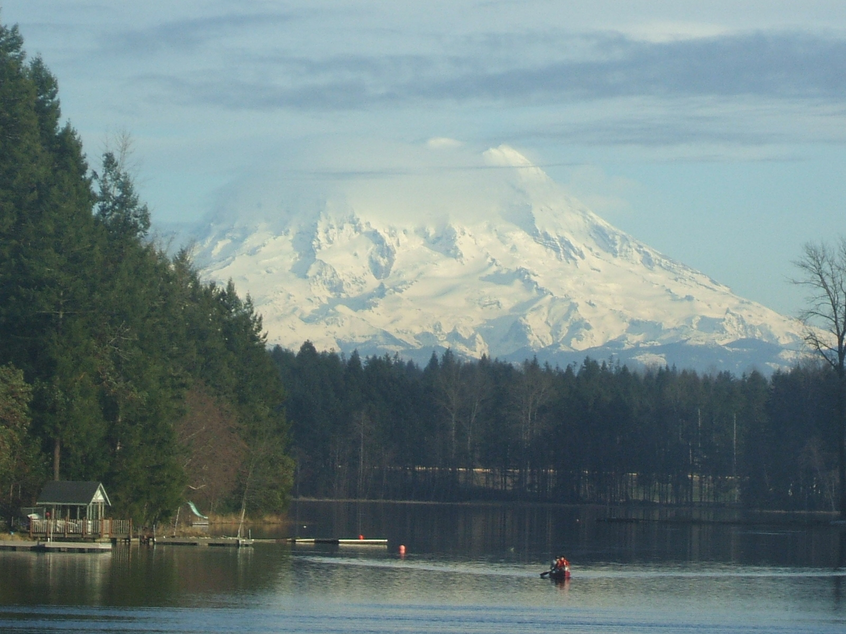
Lake Lawrence
Lake Management District
Virtual Meeting
17 July 2025
6:30-8:30 p.m.

Slide 2
AGENDA for 17 July 2025 LMD Meeting
Call to Order
  Introductions
  Approval of Agenda
Approval of 15 May 2025 Meeting Minutes
Public Communications
Recuring/Continued Business:
  Current/Proposed Budget – Janice
  Current/Proposed Work Orders/Purchases/Invoices
Old Business:
Lake Water Level & Floating Island Issue update – Frank
Senate Bill S-3518.1 update – Barry
Cyanobacteria Mgmt. Plan (CMP) update – Barry
2025 LMD Invasive/Nuisance Aquatic Weed/FWL/YFI Treatment Plan update – Barry
2025 Yellow Flag Iris Treatment Plan update – Barry
2025 Fragrant Water Lily Treatment Plan update/Recommendation - Barry
LMD Renewal 2027 Subcommittee Update – Barry/Janice
  Response from letters mailed 16 May
  Petition Response
Action Item Status Update – Barry
2025 LMD/CMP/Survey dates
Second review/Discussion/Approval of 2026-2027 Budget & Work Plan – Janice/Barry
Installation of “SHALLOW WATER SIGNS” update - Barry
New Business:
10 June & 8 July 2025 Lake Survey Results – Barry
Discuss/Approve Annual Meeting format, agenda, cost
Other Business:
Good of the Order
Adjourn

Slide 3
Call to Order
Introductions/Roll Call/Attendance
Approval of Agenda
  MOTION:
Approval of 20 May 2025 Meeting Minutes
  MOTION:

Slide 4
Public Communications
Please mute yourself until you are recognized to speak.
Please Choose the “raise your hand” option to address the committee. You will be promoted to a panelist when it is your turn to speak and be seen. To be seen, please turn on your camera. If you are dialing in, press *9 to “raise your hand.” Make sure you also choose *6 to unmute yourself.
After you have made your comments please mute yourself.

Slide 5
Recurring/Continued Business
Budget – Janice Leitzke
  Current Budget Recap/Work Orders/Purchases/Invoices (next slide)

Slide 6
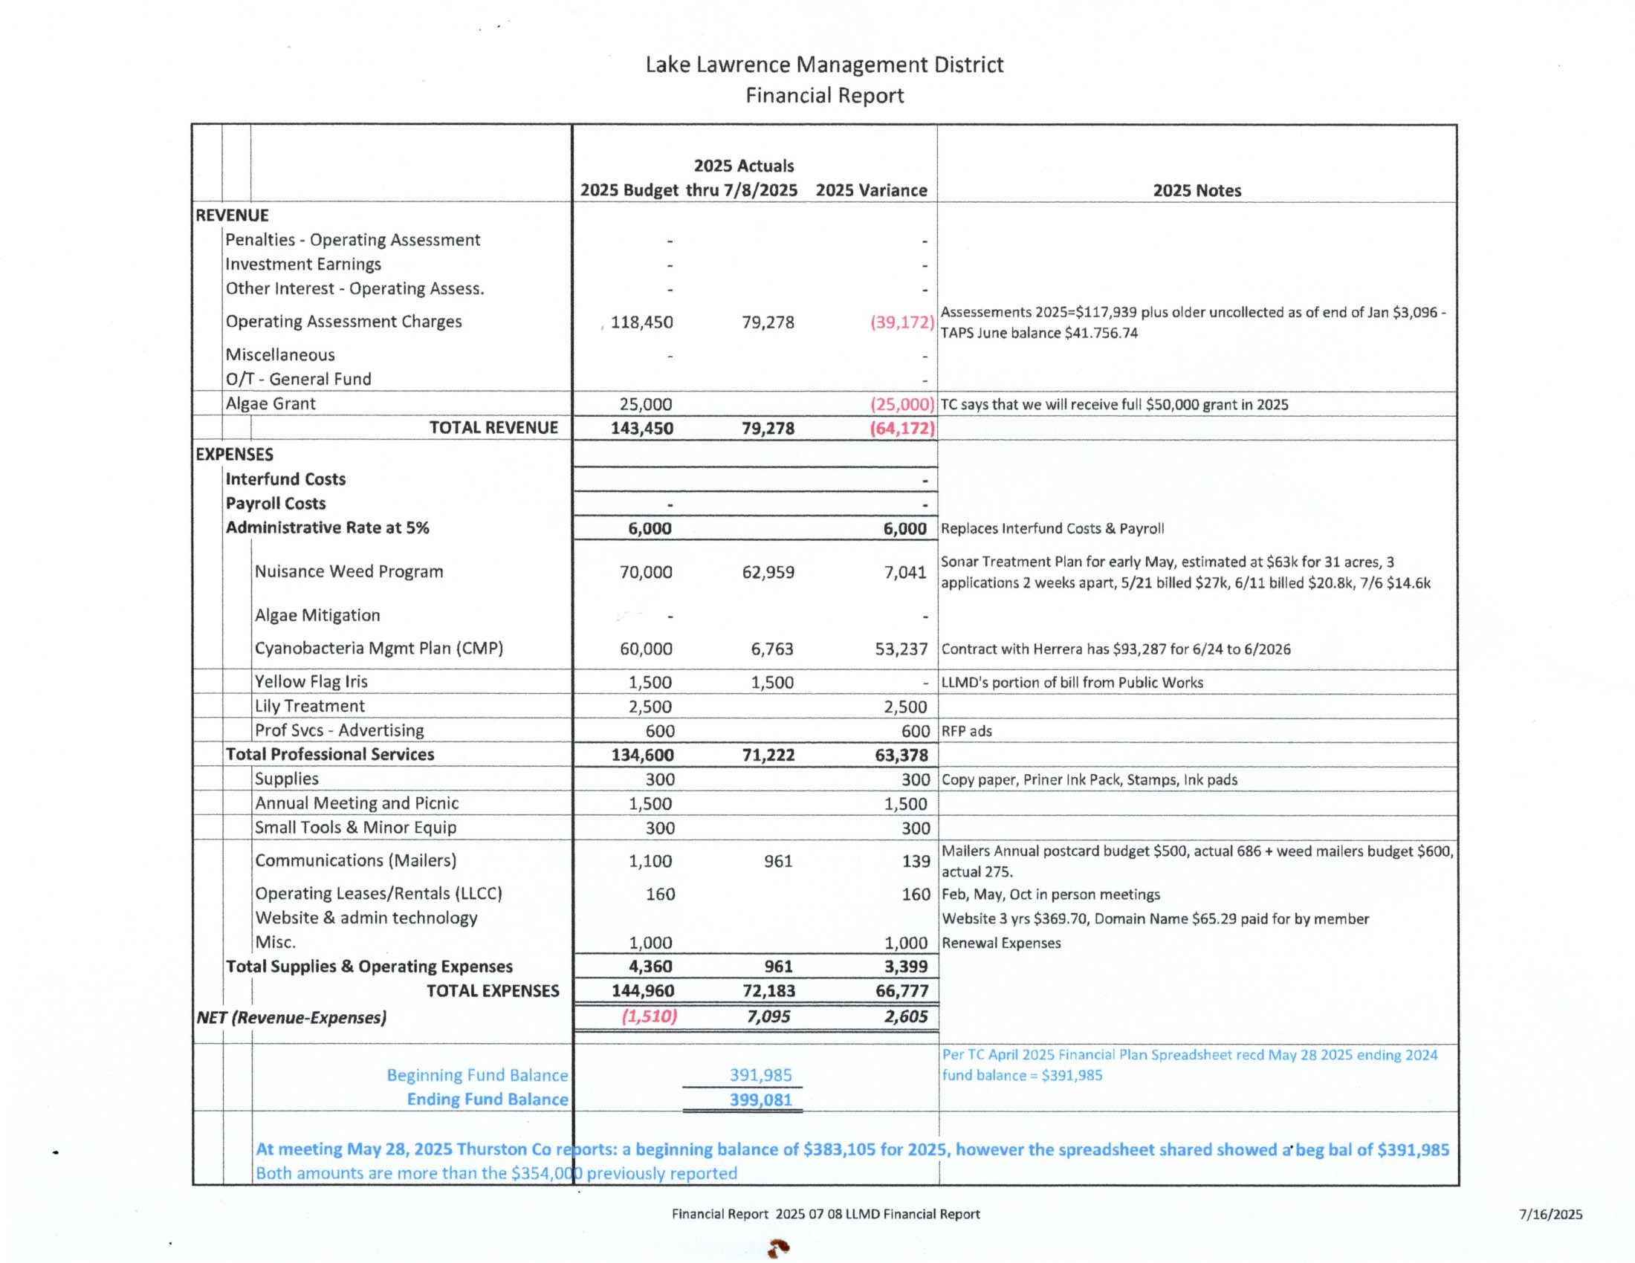
Grant funding has not yet been received from Washington State. Email from EH 17 July indicates we should receive some funding within the next week or so.

Slide 7
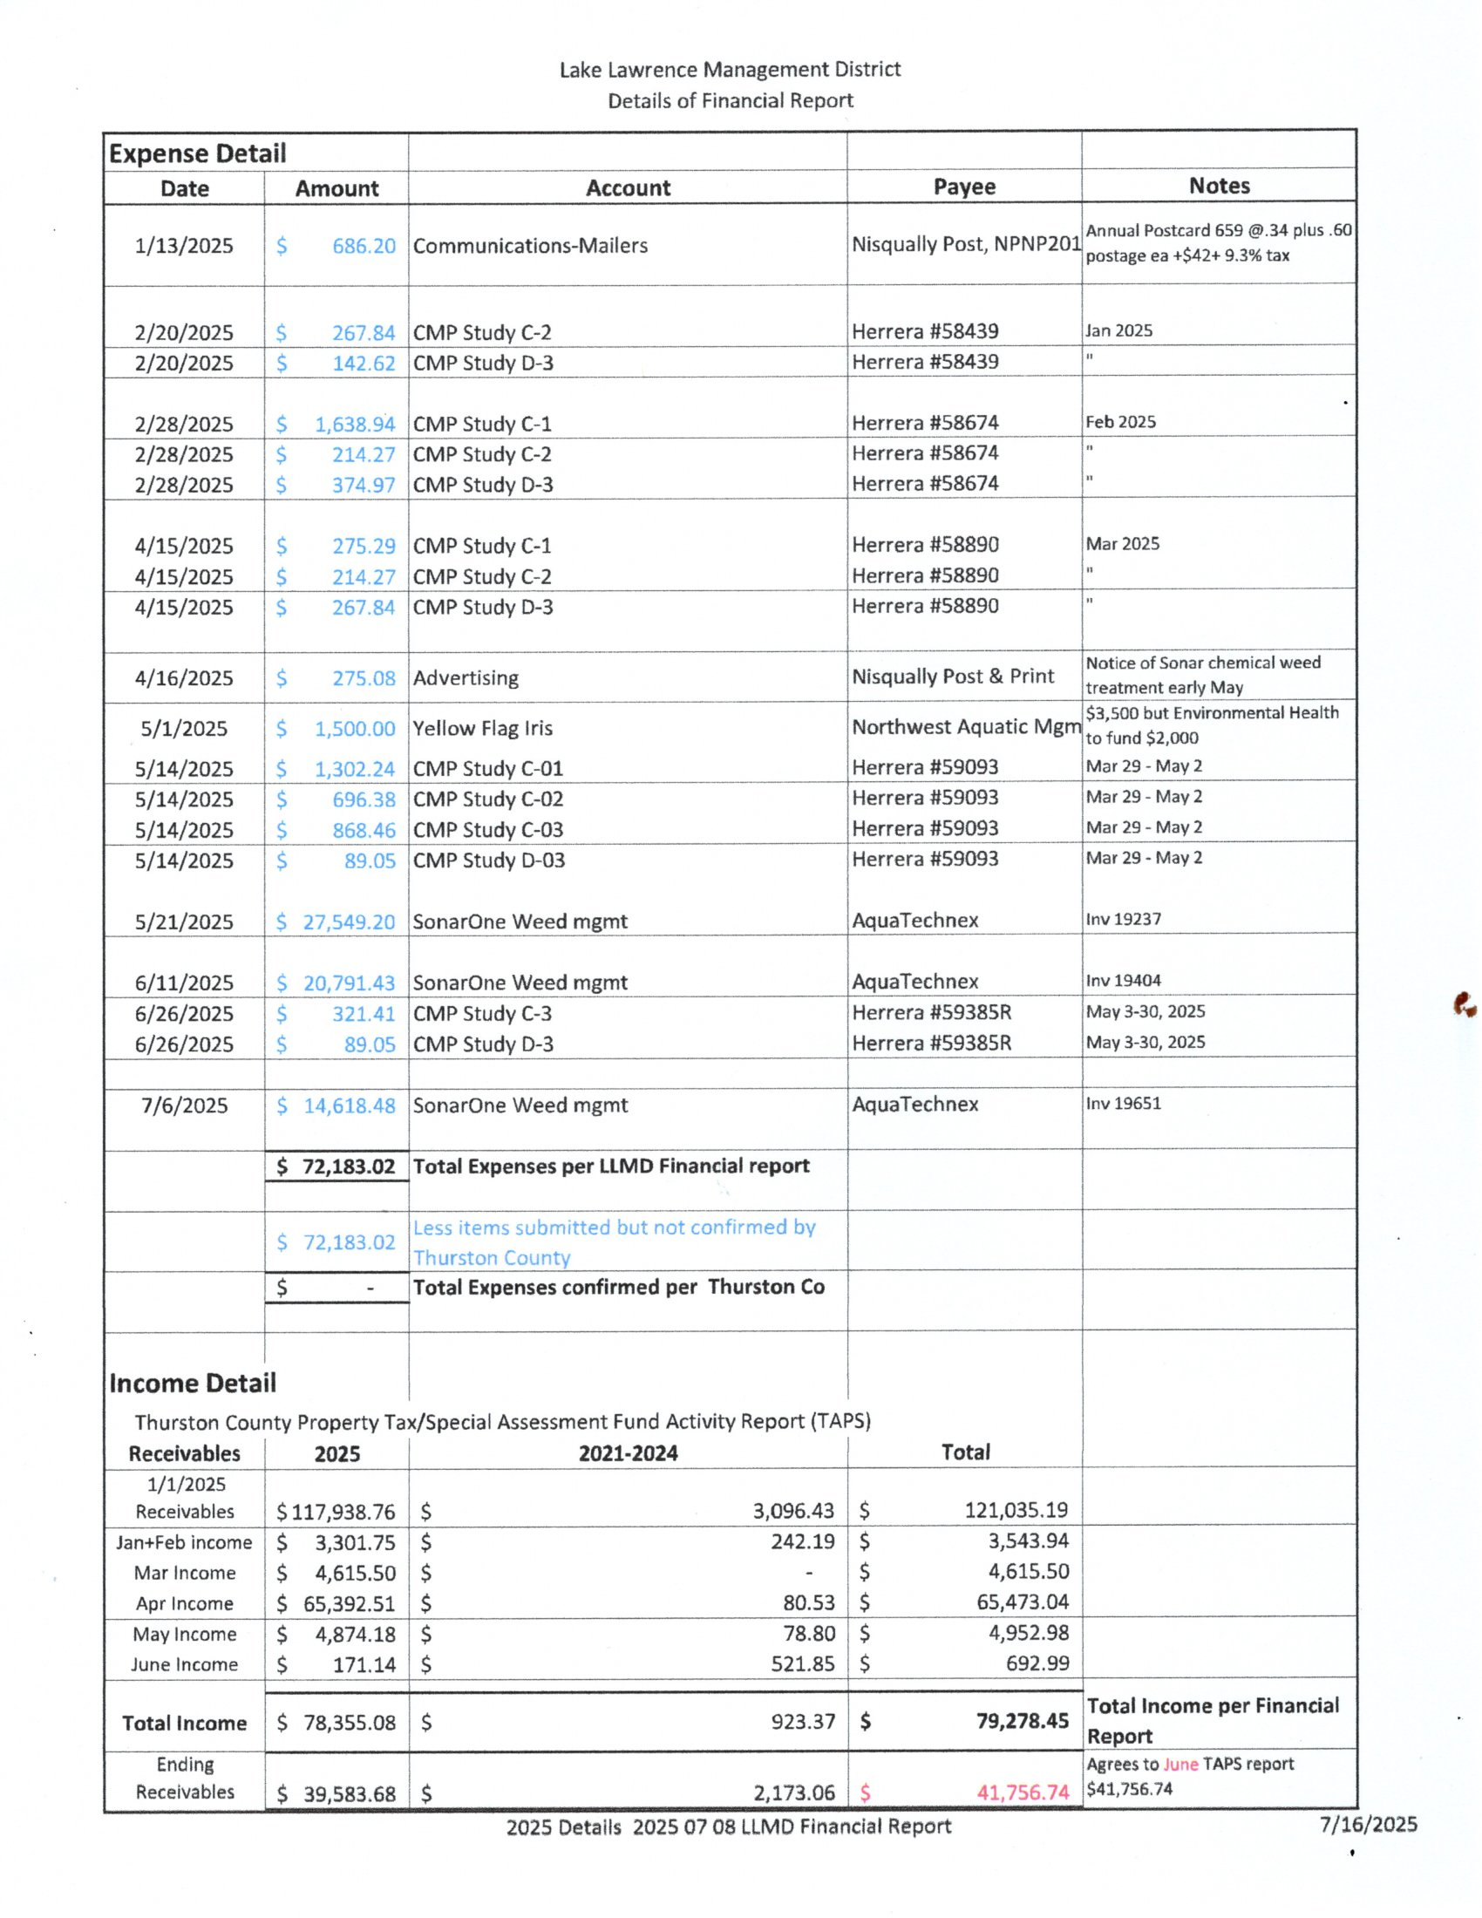

Slide 8
OLD BUSINESS

Slide 9
Lawrence Lake Surface Water Temperatures
(West Basin near HOA Park)

Slide 10
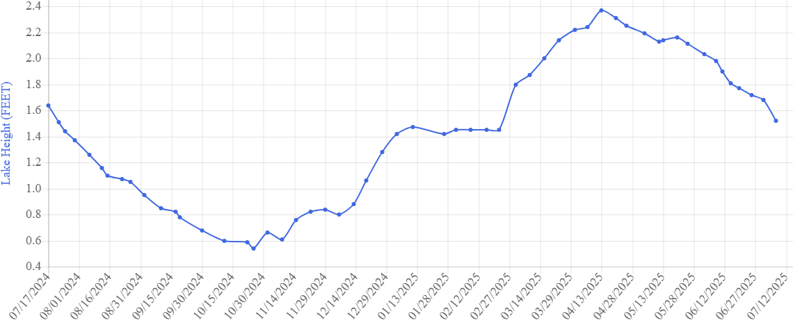
Lawrence Lake Water Surface Level ref: https://liquidearthlake.website/gauge/scaleddetailsall/47
Dam Level
1.52
7/7/25
2024
2025

Slide 11
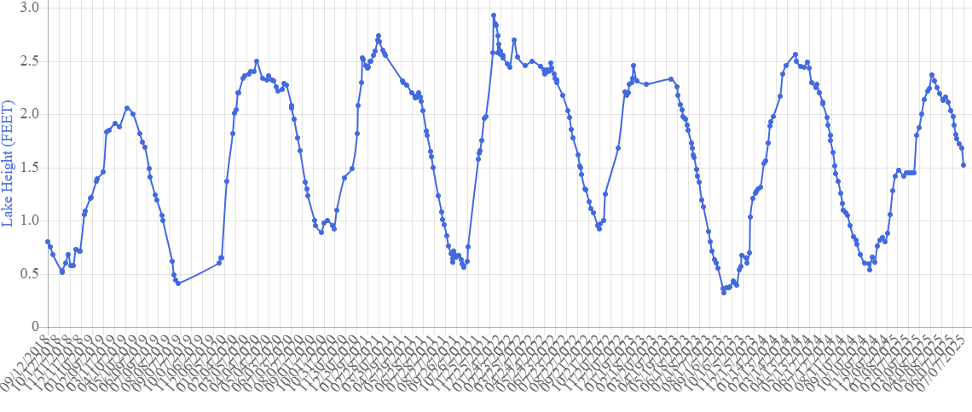
Lawrence Lake Water Surface Level ref: https://liquidearthlake.website/gauge/scaleddetailsall/47
1.52
7/7/25
Dam Level
2019
2020
2021
2022
2023
2024
2025
Lake levels on 7/7

Slide 12
Backup
Retained for continuity.
Previously presented in March 2025 LMD meeting.

Slide 13
Floating Mat Issue: status
2022-2023 Numerous communications LMD/T-County/WA DNR/WA FW
Oct 23 Site survey by boat: LMD/FW/DNR
Dec 23 DRAFT Presentation vetted through Lawrence Lake LMD Steering Committee
Dec 23 Presentation sent to State Representative Abbarno’s Office
  26 January 2024 Presentation to Rep Abbarno, FW/DNR
April 24 Lawrence Lake’s State Voting District change: Reps Wilcox, Barkis; Sen McCune
4 April 24 New floating mat discovered, towed and secured in protected cove
13 May 24 LMD Floating Mat Presentation to Rep Wilcox
    Staff directed to contact State DNR leadership for follow-up action
1 July 24 Follow up action: Presentation to WA State Agencies:
    Presentation Major Point: State Constitution: DNR has Jurisdictional Authority for lake bottom beyond High Water Mark
  Attended: Departments of Ecology, Fish and Wildlife representatives
  Did not attend: DNR, Hilary Franz – Commissioner of Public Lands (elected official)
3 Sep 24 ECY/DNR/FW meeting with Rep Wilcox staff
  Lake Lawrence eutrophication is a “natural process”
  “Human influence might be a beneficial premise for a study”
  Sediment removal is LMD responsibility

Slide 14
Floating Mat Issue: status/update
  28 Oct 24 LMD presented the Floating Island Issue to Army Corp of Engineers (ACE) federal regulatory representative Alexandra Hammond, Seattle District Office
    Summary: ACE is at the tail end of any process or planning for dredging etc but can assist with any required federal permits including EPA
    Current Status: May 2025
      Floating Island issue remains a safety issue for Lawrence Lake
        No reported incidents in 2025 (so far)
      Presentations to Representatives Orcutt, Abarno negated by redistricting (20>2) Apr 2024
      Presentation to Representative Wilcox negated by Nov 2024 election/retirement
      State ECY/DNR/FW representatives assume no responsibility for the Floating Island Issue
      Federal ACE will only assist with federal “tail end” permitting (e.g., EPA)
      Proposed actions for Steering Committee consideration
      Tour Representative Marshall and ACE representative Hammond
      Incorporate current Cyanobacteria lake study (contractor) findings/recommendations into presentation
      Steering Cmte letter To: Commissioner of Public Lands, cc: BoCC, State Representatives: Barkis, Marshall

Slide 15
Senate Bill S-3518.1 Update
  30 May DFW sent us a letter outlining their concerns
  4 June sent email to WA LMDs to update their contact information
  6 June sent DFW ltr and other info to WA State LMDs for their input by 14 Jun
  14 June sent email to WA State LMDs with 2 dates for virtual mtg 19 & 20 Jun
  19 & 20 June met virtually with WA State LMDs
  24 June sent email with ltr to DFW addressing their concerns
  30 Aug WALPA sent email – would like to be involved and support revision of RCW 36.61. Want to work with LMDs on changes. Waiting for date/time to set up mtg to discuss.
  2 Sep sent email to DFW asking for a response – Responded that they will have an answer by mid-September.
  18 Oct 2024 rec’d letter from DFW reiterating their position that the bill must include a change to the RCW regarding restructuring of public entity assessment fees in paragraph 36.61.160.
  4 Nov 24 – Email to our legislative sponsors of the bill and WDFW representatives letting them know where the LMDs stood, asking for their input on the LMD Assessment Table and discontinuing any effort to pursue this legislation this coming session until we have had time to further discuss the bill with all City/County LMD managers and other stake holders.
  21 Nov 24 – Email to all LMD Leadership, WALPA, and LMD City/County managers requesting their review/discussion of proposed changes to RCW 36.61 and WDFW’s concerns.
  16 Jan 25 – Virtual meeting with LMDs, WALPA and City/County LMD Representatives to discuss bill, identify any changes desired, confirm support for bill and existing changes and identify next steps. WALPA agreed to moderate discussion with DFW – Clark to reach out to them. WALPA agreed to reach out to all city/county LMD representatives to get them involved (ongoing).

Slide 16
Cyanobacteria Management Plan (CMP) Timeline
G
  Nov 2023 - Grant request submitted
  Jan 2024 - Grant approved by Ecology – funding not until July 2024
  Feb 8, 2024 – RFP submitted for contractor to do plan.
  8 Mar 2024 – BoCC approved RFPs Clerk of the Board issued Public Notice
  Apr/May 2024 – Bids received and evaluated
  May/June 2024 – Contract issued (June 18th)
  June/July 2024 – Contractor begins study – EH held virtual kickoff meeting with contractors 12 July
  25 July 2024 – Mtg #1 2hr Public Mtg to discuss project objectives & monitoring plan
  July 2024 – SC receives 1st Draft of Quality Assurance Project Plan (QAPP) for review (we have 2 wks)
    6 Sep 2024 – Rec’d 1st Draft of QAPP for review - Reviewed same day.
    9 Oct 2024 – Rec’d Final Draft of QAPP for review – Signature copy going out 11 Oct.
  August 2024 – Ecology reviews QAPP – 6 Sep – 8 Oct 24?
  Aug/Sep 2024 – Final review of QAPP – 9 Oct 24
G
G
G
G
G
G
G
G
G
G
G
G = Green = Completed On Time
Y
Y = Yellow = Late – Program Jeopardized
R
R = Red = Mission Fail

Slide 17
Cyanobacteria Management Plan (CMP) Timeline
(continued)
G
  25 Sep 24 – Lake Sediment Sampling (Completed)
  Oct 24-Oct 25 – LMD responsibility. Weekly water level monitoring/reporting (On track)
  May 2025 – Mtg #2 1 hr. w/SC to discuss monitoring update (Monday 5 May 2025)
  Dec 2025 – Mtg #3 2 hrs. w/SC to discuss Phosphorus Budget & Mgmt. Alternatives (Thursday 11 Dec 2025)?
  Apr 2026 – Mtg #4 2 hrs. Public Mtg to go review/discuss DRAFT CMP (Thursday 17 April 2026)?
  Jun 2026 – MTG #5 2 hrs. w/SC to discuss final CMP. (Thursday 11 June 2026)?
  April 2026 – RFP issued for contractor to implement plan
  May 2026 – Contractor identified
  Jun-Oct 2026 – Plan/contract/treatment executed.
G
G
G
G = Green = Completed On Time
Y
Y = Yellow = Late – Program Jeopardized
R
R = Red = Mission Fail

Slide 18
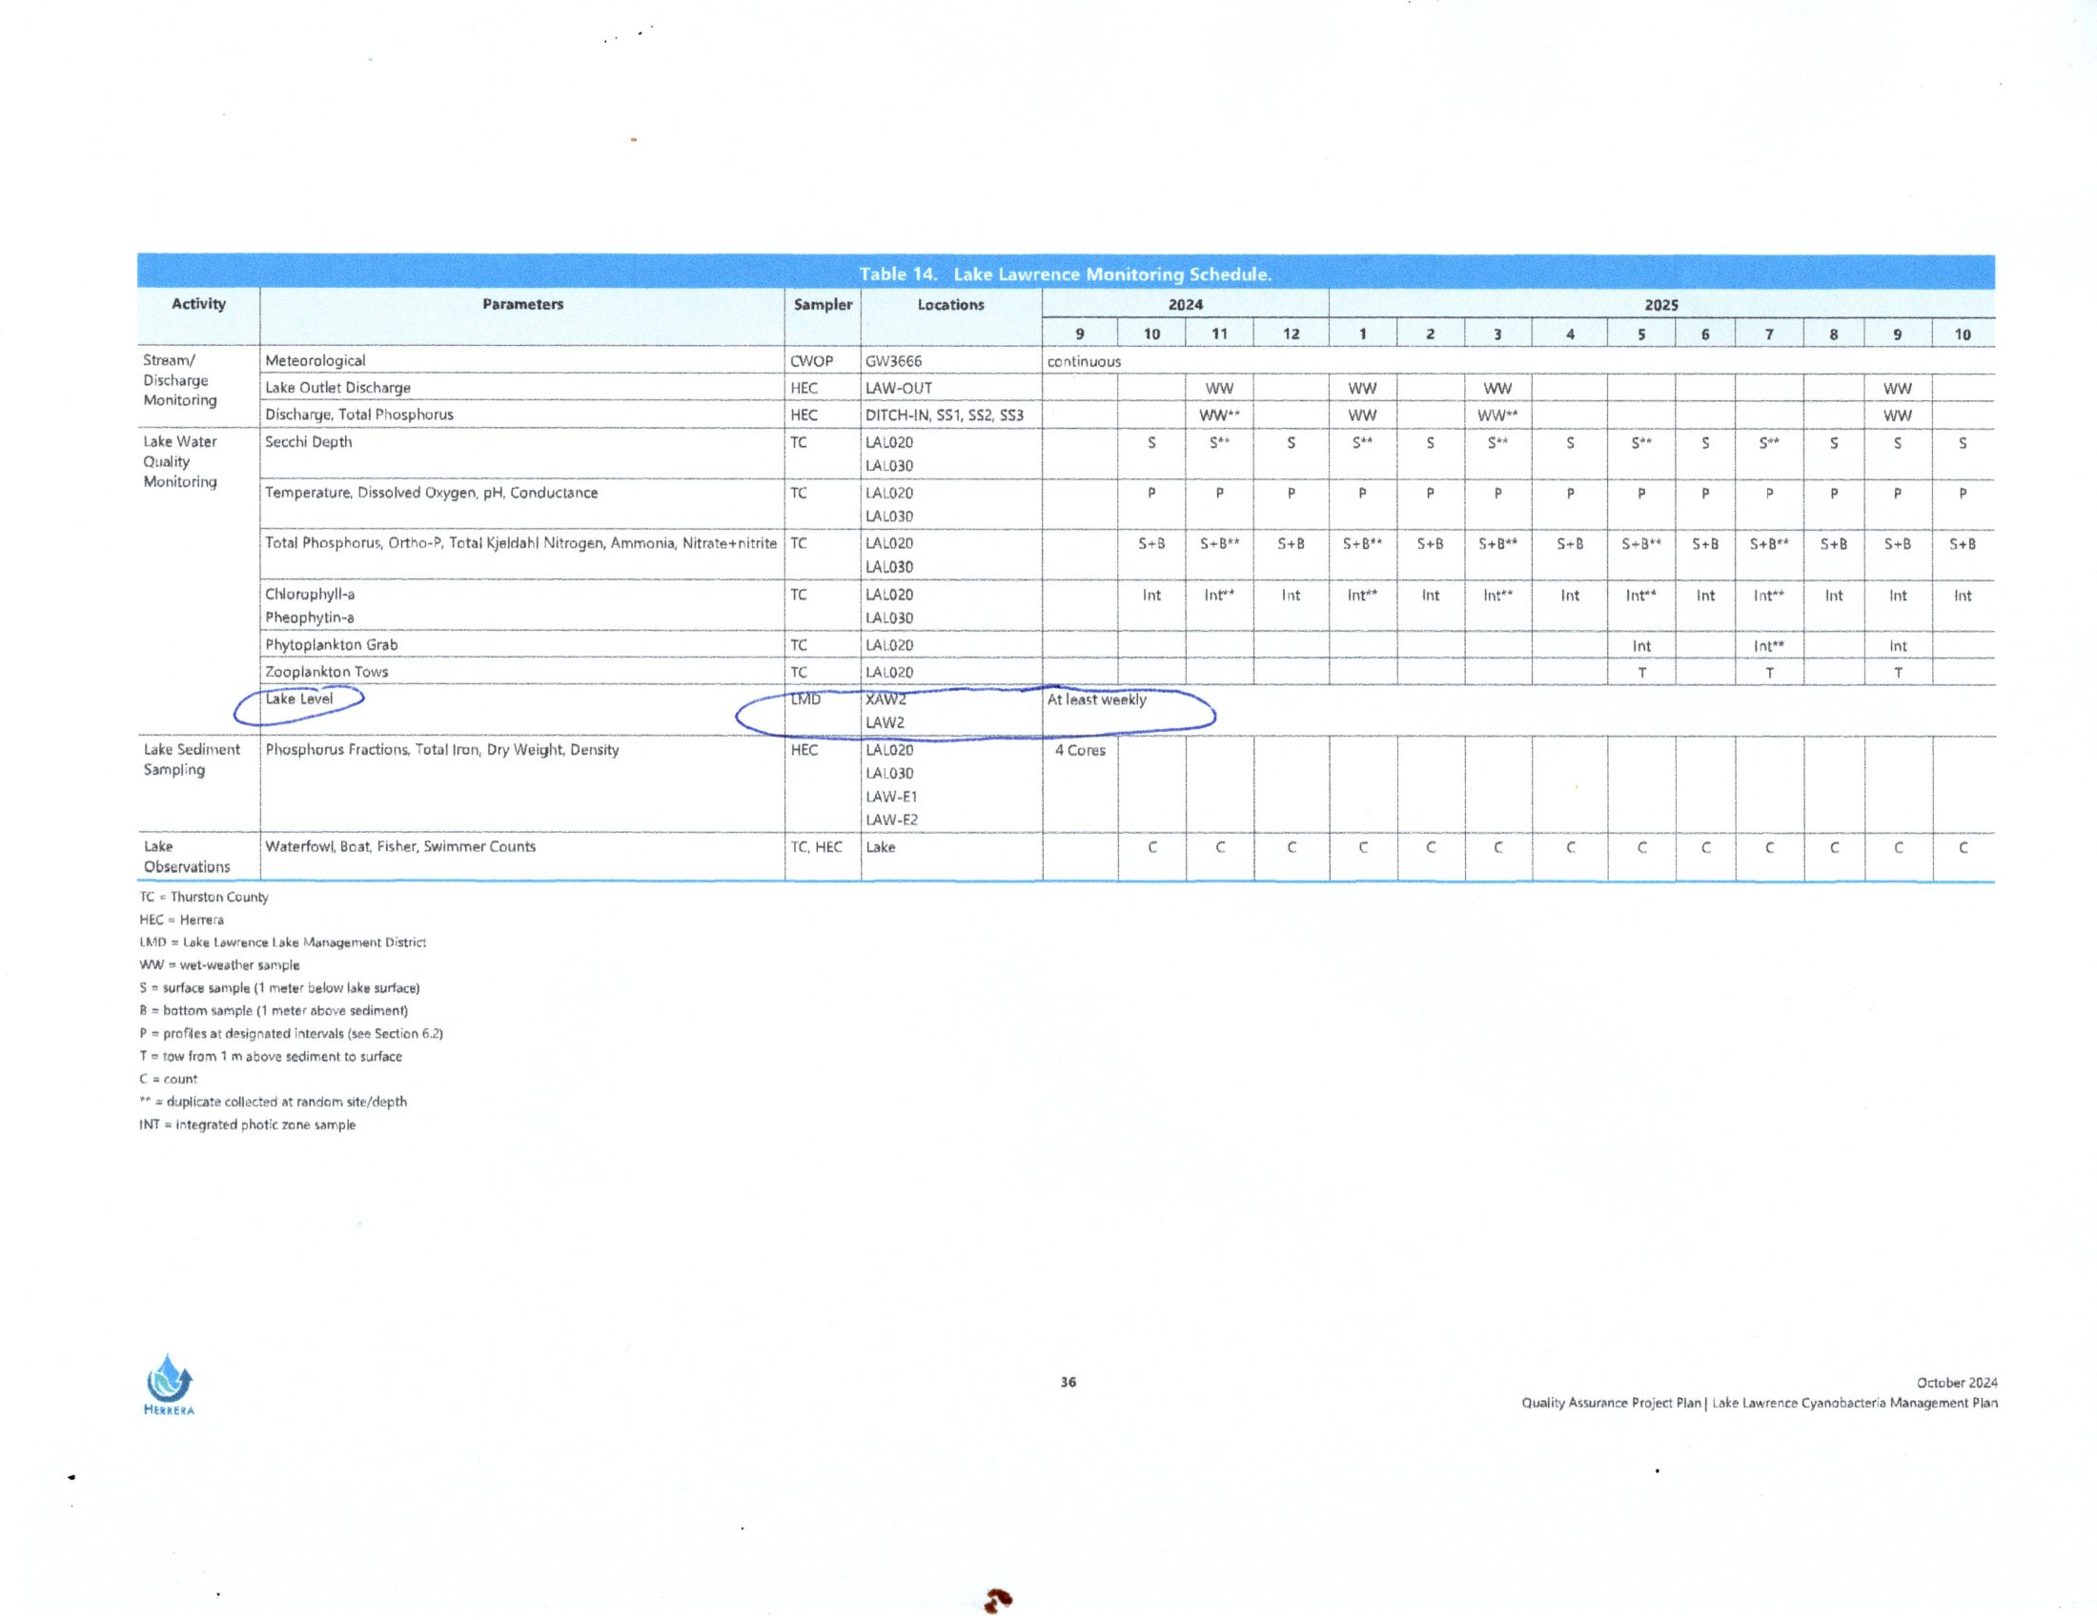
Dates for testing stream/discharge monitoring moved
to the right (25 Feb, 8 Apr) timeframe due to very low rainfall
between November 2024 and February 2025)
Stream flow testing pushed to the right many times due to lack of rainfall.
First test conducted – 25 February 2025
Second test conducted – 8 April 2025
Two more test needed – looking at Nov/Dec 2025

Slide 19
2025 LMD Invasive/Nuisance Aquatic Weed Treatment Plan
G
  Nov 2023 – LMD budget $70,000 for 2025 for Invasive/Nuisance Aquatic Weed Control.
  20 August 2024 – Survey Committee & ARS conduct end of year survey to assess type of weeds and density.
  October 2024 – Virtual meeting with contractor to discuss 2025 treatment plan – Contractor contacted 3 Oct 24 – awaiting meeting date/time. Met with contractor 21 Nov 2024.
  Prior to Feb 2025 - Contractor to provide cost/application recommendations for Spring 2025 treatment of Curly Pondweed. Increase treatment area to southern end of lake – total area to be treated = ~56 acres. 22 Feb 25 – Cost est. = $57,000 includes additional 30 acres.
  20 March 2025 – LMD Mtg SC changed treatment area which required new quote from contractor.
  17 April 2025 – LMD Special Session to discuss/approve new treatment plan.
  May - APAM Notice mailed to lake front residents 10 days prior to any treatment. Suggested by contractor at 21 Nov 24 meeting. APAM Notice Cost est. $275. Mailed 16 April 2025.
  20 April – 20 August - Survey Committee – monthly lake surveys.
  15 May – 15 Jun – Treatment of invasive/nuisance aquatic weeds using Sonar One. Recommended by contractor. Based on SC change 20 March contractor recommended Sonar One. First Treatment 6 May, Second Treatment 4 June, Third Treatment 30 June.
G
G
G
G
G
G
G
G
G
G = Green = Completed On Time
Y
Y = Yellow = Late – Program Jeopardized
R
R = Red = Mission Fail

Slide 20
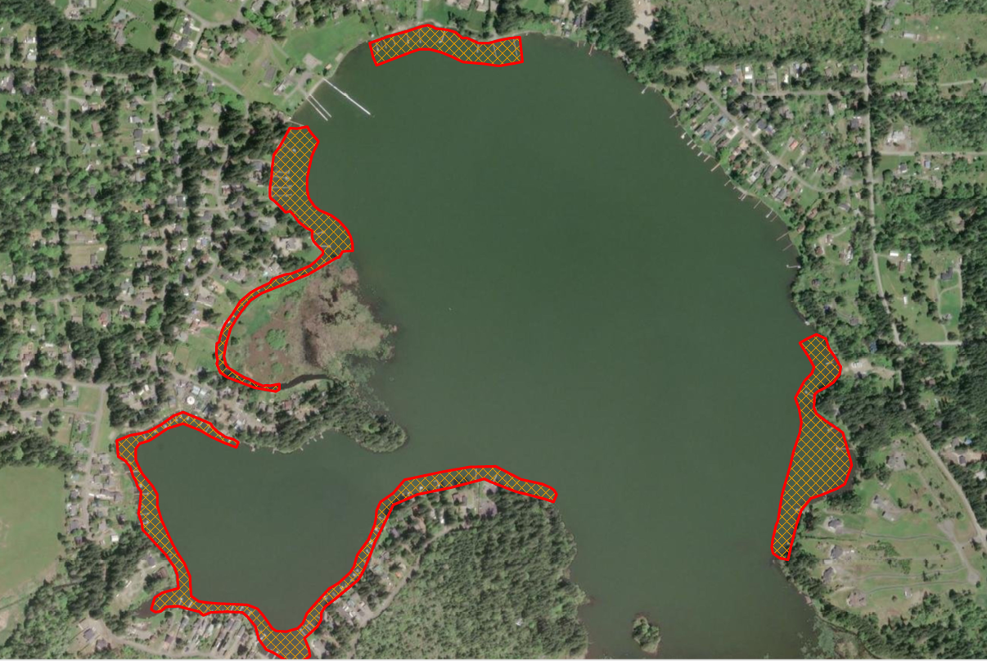
Sonar One 2025
31 Acres
3 applications – two weeks apart
First Treatment: 6 May 2025
Second Treatment: 4 June 2025
Third Treatment: 30 June 2025
Cost: $63k or $2032 per acre
Previous Treatments:
2021 – Sonar One – 25 Acres - $1,856 per acre
2022 – Aquathol K – 33.5 Acres - $1,325 per acre
2023 – No treatment
2024 – Galleon SC – 26 Acres - $1,097 per acre

Slide 21
2025 LMD Yellow Flag Iris Treatment Plan
G
  Jan/Mar – Send out and Receive permission letters for treatment:
    Jan 7, 2024 – Send out first email to capture permission letters from 24 private parcels
    Feb 7, 2024 – Send out second email sent.
    April 1, 2024 – Send permission letters to PW Noxious Weed
  Apr/May – Send out treatment notification cards. Sent out 16 April 2025
  May – PW Noxious Weed treats YFI. Email from Mike Murphy, Noxious Weed Mgr – Expect to treat 13-14 May 2025. Changed to 14-15 May
  Cost to LMD $1,500 Approved at 20 Mar Mtg
G
G
G
G
G = Green = Completed On Time
Y
Y = Yellow = Late – Program Jeopardized
R
R = Red = Mission Fail

Slide 22
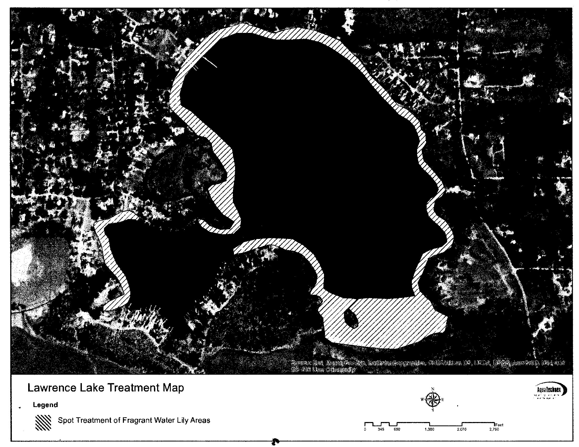
2025 LMD Fragrant Water Lily Treatment Plan
  15 Jul – 15 Aug – Treatment of Fragrant Water Lily, if required (to be determined in June or July 2025 following lake survey).
2024 Treatment – 2.5 Acres
Treatment Costs:
Jul 19 - $1,540
Jul 20 - $1,517
Jul 22 - $2,373
Sep 24 - $2,500
Aug 25 – Est. $1,875
Recommend 2025 Treatment
End of August Approx 1.5 Acres
Motion to approve FWL Treatment in August 2025
G
G = Green = Completed On Time
Y
Y = Yellow = Late – Program Jeopardized
R
R = Red = Mission Fail

Slide 23
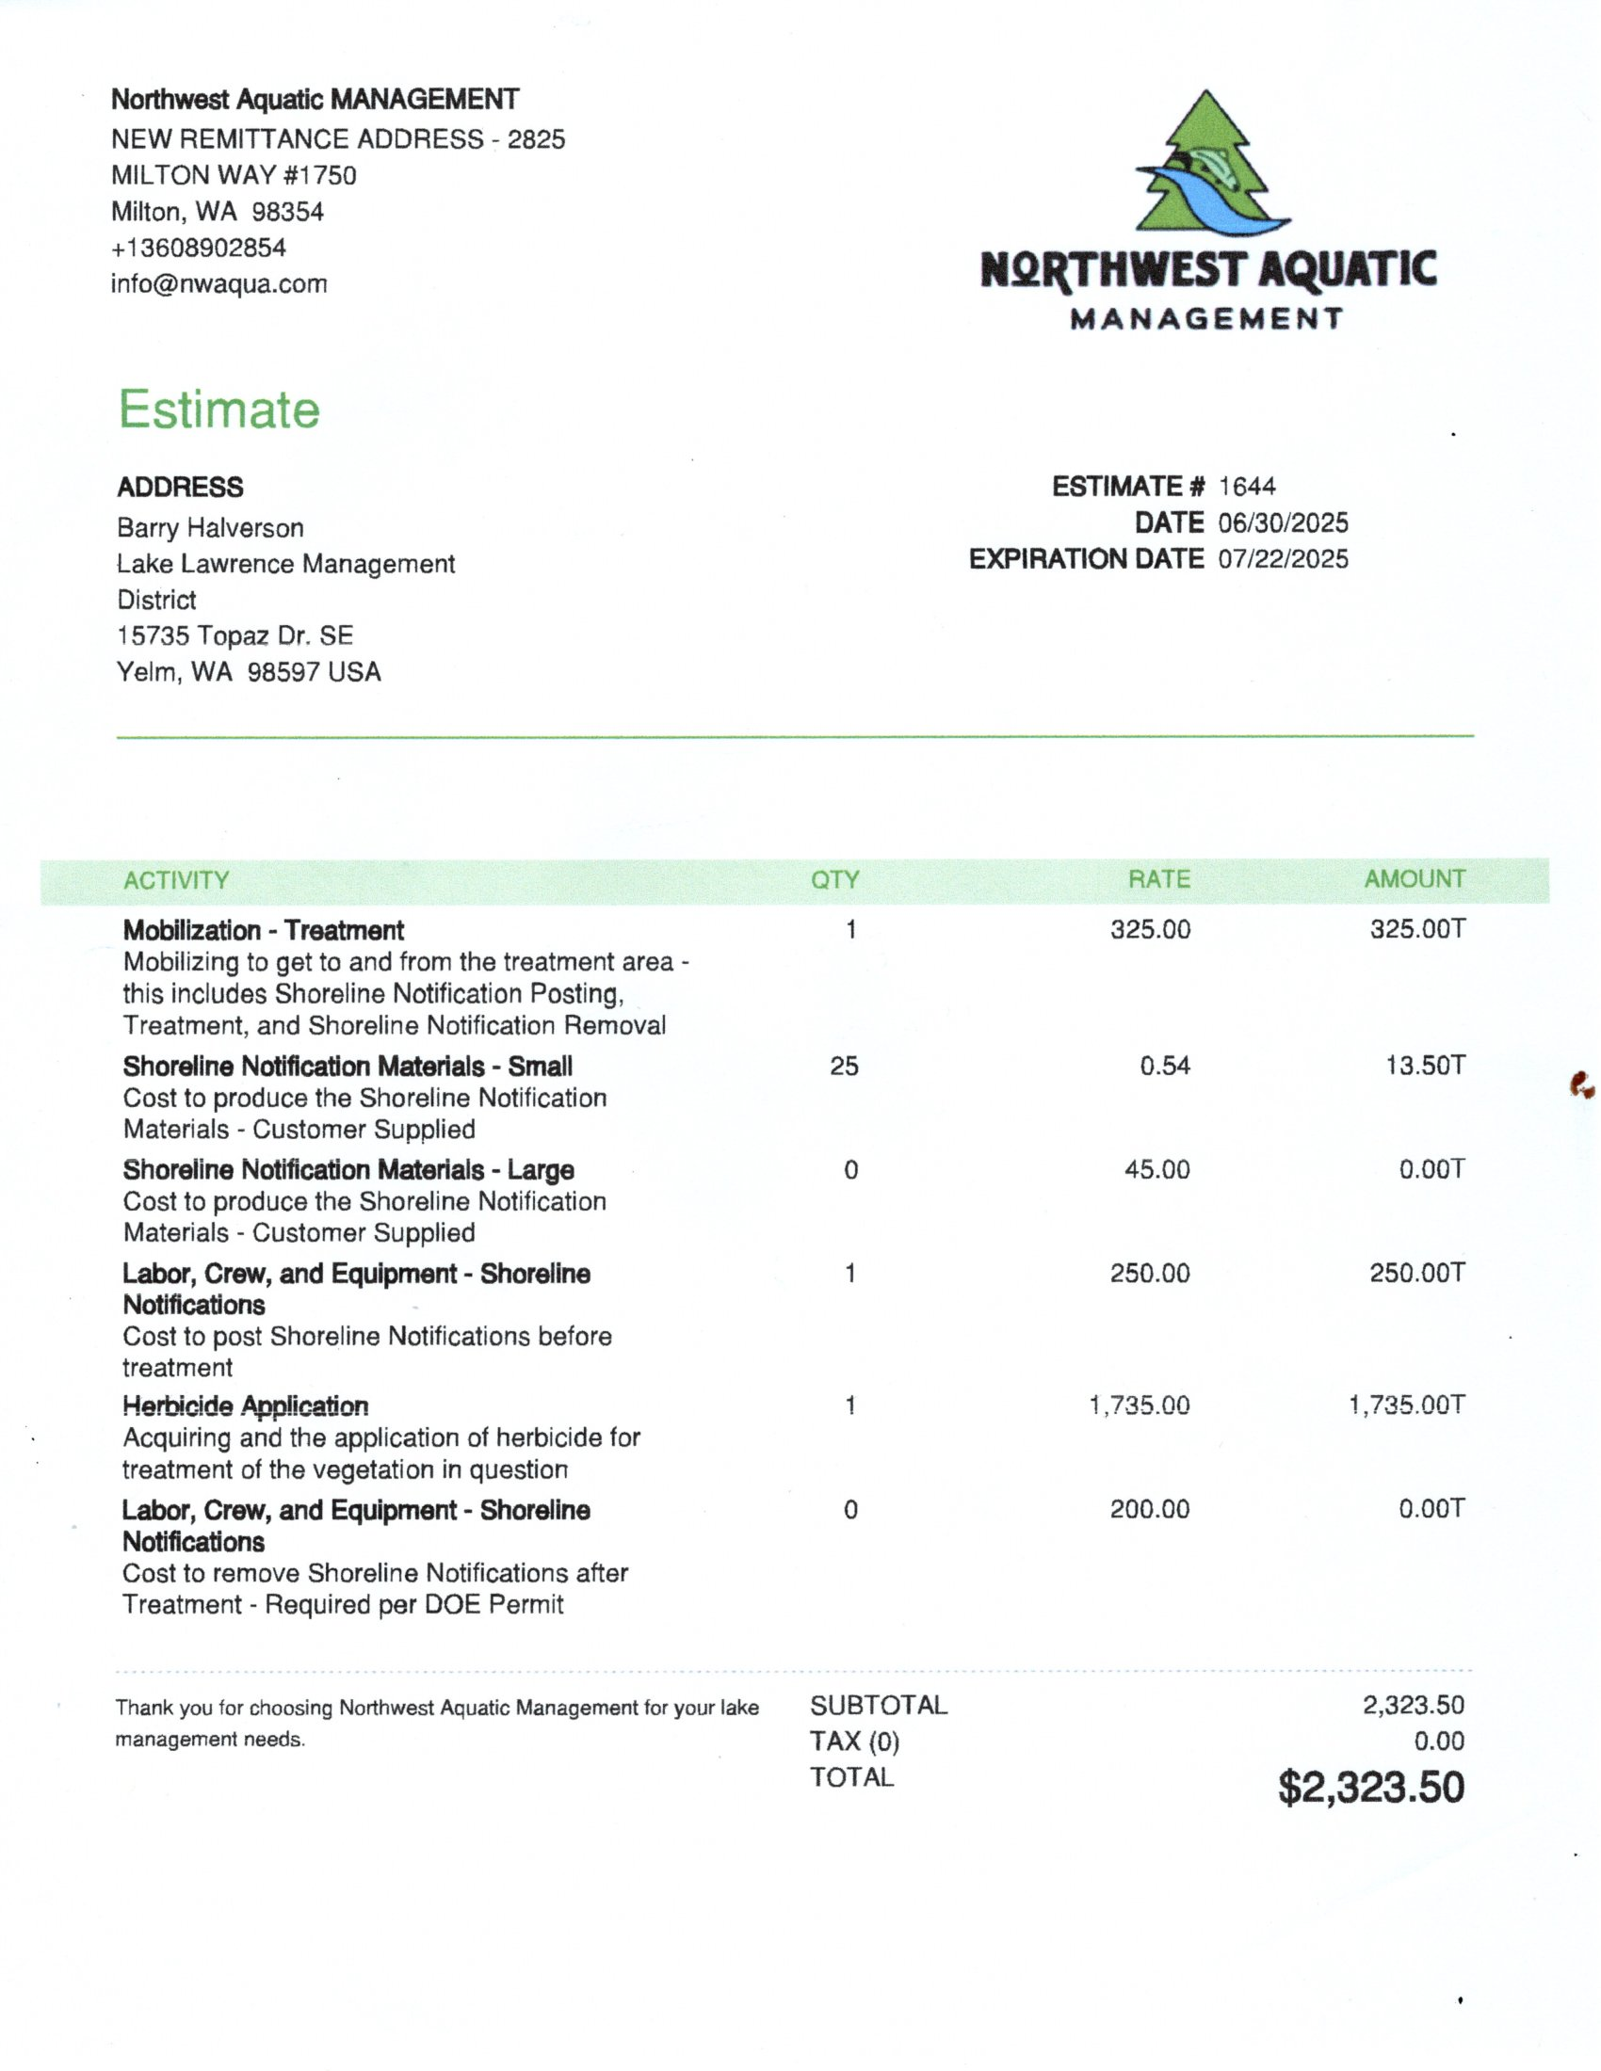
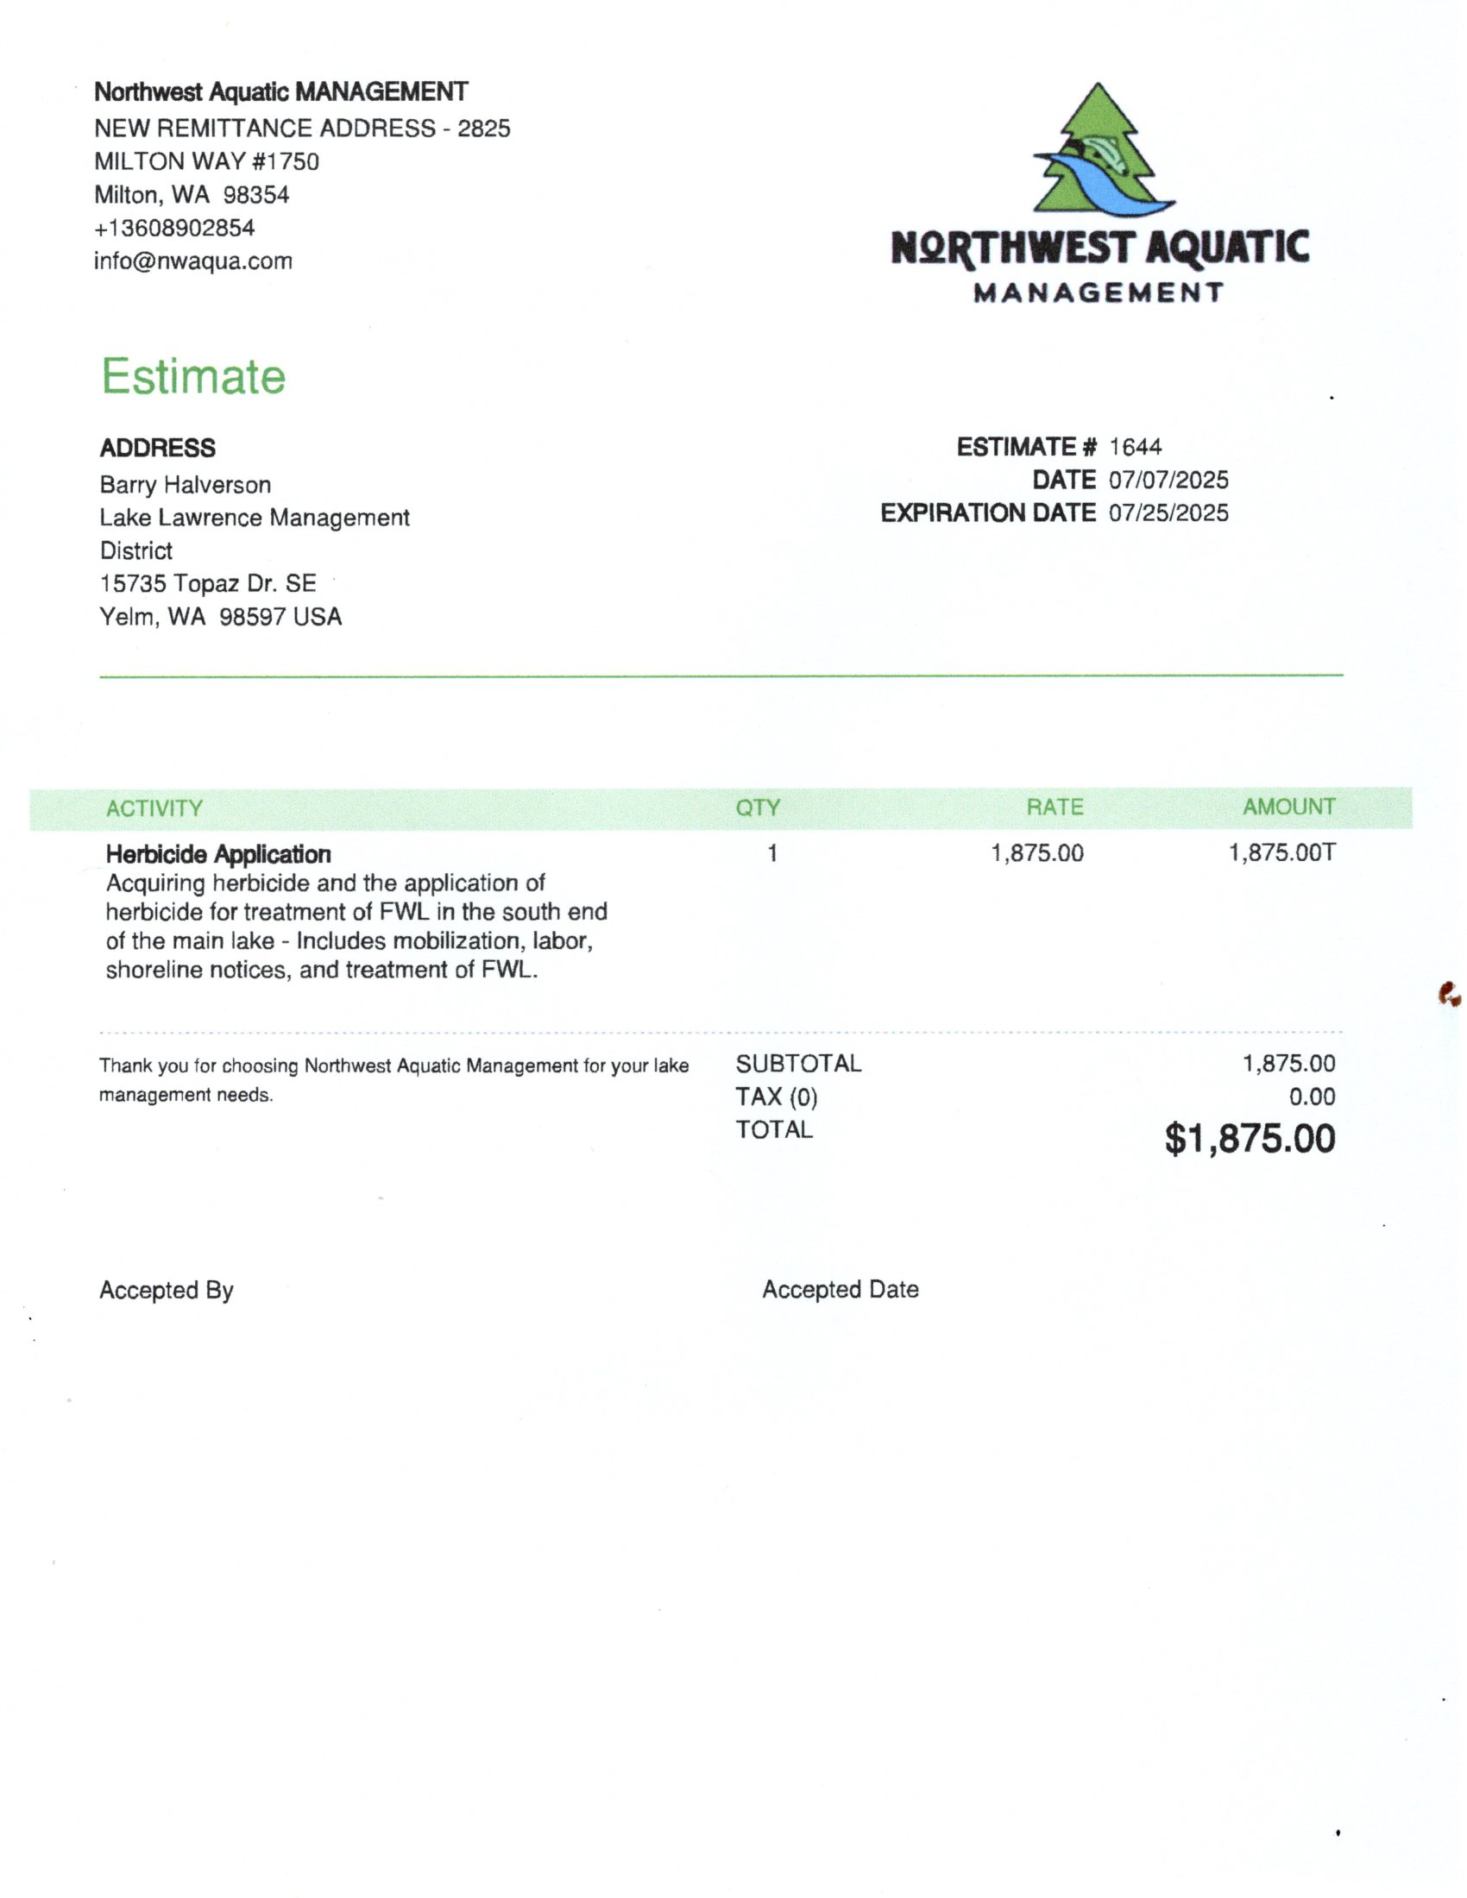

Slide 24
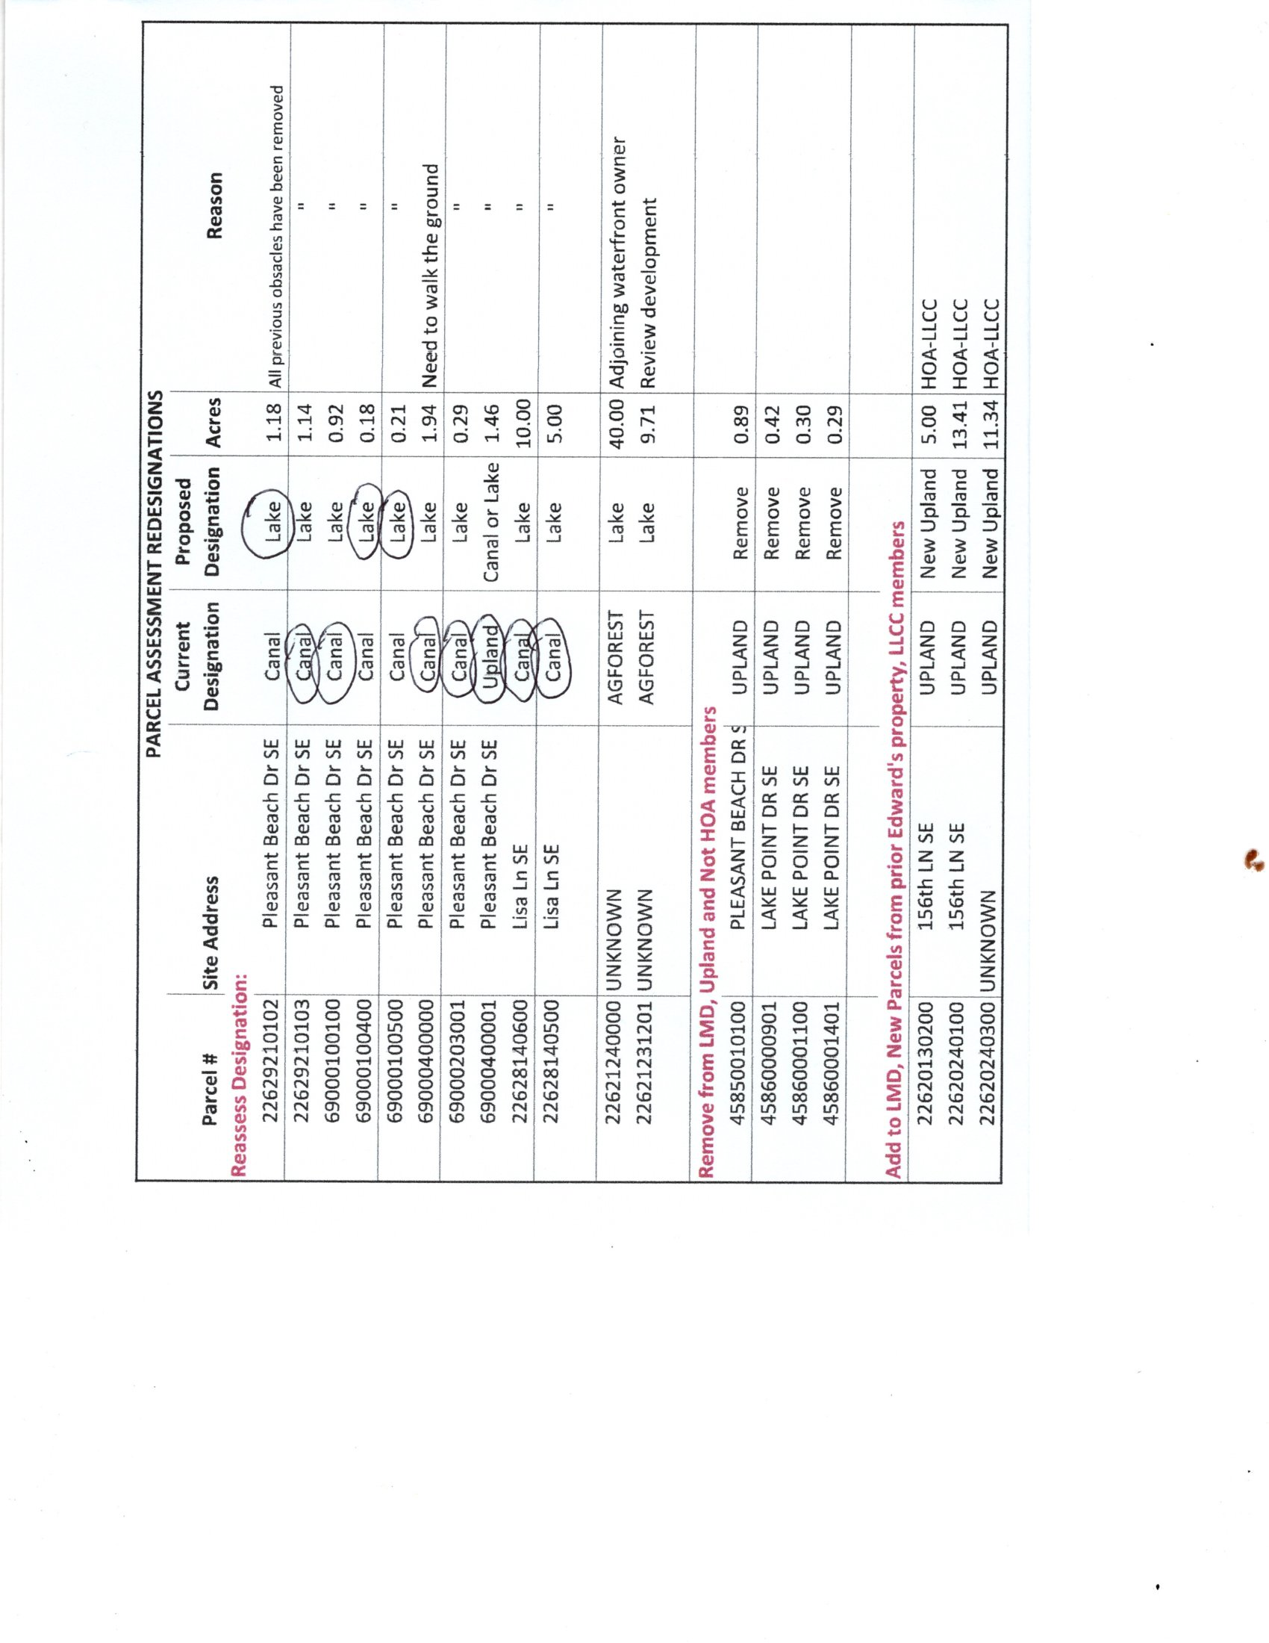
Letters sent 16 May 2025
Responses:
None

Slide 25
HOW DO WE GET THERE?
NEXT STEPS (IAW RCW 36.61)
G
20 Mar 2025 – SC decisions on renewal of LMD
Mar 2025 – Write petition/resolution of renewal – Draft written 4 Mar 25
Mar 2025 – Submit petition to County for approval - Approved by EH 5 Mar 25
1 May 2025 – Sent petition to all property owners for signature (requires 20% by acreage of assessed properties). We have 592 acres of assessed parcels. Require signatures of parcel (assessed) owners owning at least 119 acres of property within LMD to move forward. We have rec’d petitions for 200+ acres (34%) as of 17 June. 2nd notification sent 15 May 25. 3rd notification sent 2 Jun 25. 4th & final notification sent 16 Jun 25.
Jul – Sep 2025 – Follow up with door-to-door engagement with LMD members to obtain petition signatures. Not necessary. We have exceeded the number of required signatures.
Aug – Sep 2025 – BoCC approves LMD renewal to be in the best interest of the public and sets public hearing by resolution of intention. Publishes hearing notice in local paper of record (Nisqually Valley News) (2x) NOTE: 15 July BoCC approved Long Lakes Public Hearing for 5 Aug 25.
Sep - Dec 2025– Public hearing – BoCC determines if LMD is in public interest or not
G
G
G
G
G
G = Green = Completed On Time
Y
Y = Yellow = Late – Program Jeopardized
R
R = Red = Mission Fail

Slide 26
Thurston County Staff Response to Petition
Joshua Cummings, Assistant County Manager.
Thanks for reaching out. Please know this inquiry has been in review for a more complete understanding of the request.
The County owns property along Lake Lawrence (~15 acres).
As a lake property owner the County may sign on to the LMD renewal petition.
The BoCC will be approving the LMD renewal.
To staff’s knowledge the County has not previously signed onto a renewal petition for a LMD.
Here is the initial perspective:
Given the County is the approving authority of the LMD it seems most appropriate for the County to not be a party to the renewal petition as well.
At first review this appears to put the County in a conflict-of-interest position, and recommend that we do not join the LMD as a petitioner.
I believe the County’s support for LMD’s would be demonstrated when the Board approves the petition.

Slide 27
FINAL DRAFT LMD RESOLUTION OF INTENT
Motion to Recommend DRAFT LMD Resolution of Intent be forwarded to Environmental Health along with Petitions for BOCC to schedule Public Hearing
Yes_____ No____
As of 17 July:
  205 Parcel Owners have submitted Petitions 30%
  225 Acres of 592 Acres owned by Fee Payees 38%

Slide 28
HOW DO WE GET THERE?
NEXT STEPS (IAW RCW 36.61) (continued)
Feb - Mar 2026 – BoCC approves LMD proposal and adopts resolution for vote of property owners
Mar - Apr 2026 – County auditor mails ballots and resolution to all property owners
May 2026
  Majority of votes NO – LMD will dissolve December 2026
  Majority of votes YES – LMD will renew January 2027
Jun 2026 – BoCC adopts ordnance creating LMD & sets public hearing to consider objections to roll of rates and charges
Jul 2026 – Notice of Public Hearing published in local paper of record (Nisqually Valley News) 2x
Aug 2026 – BoCC holds public hearing on roll of LMD charges
Sep 2026 – BoCC adopts or amends roll
Oct 2026 – BoCC sends roll of rates and charges to County Treasurer to place on 2027 property tax statements
G
G = Green = Completed On Time
Y
Y = Yellow = Late – Program Jeopardized
R
R = Red = Mission Fail

Slide 29
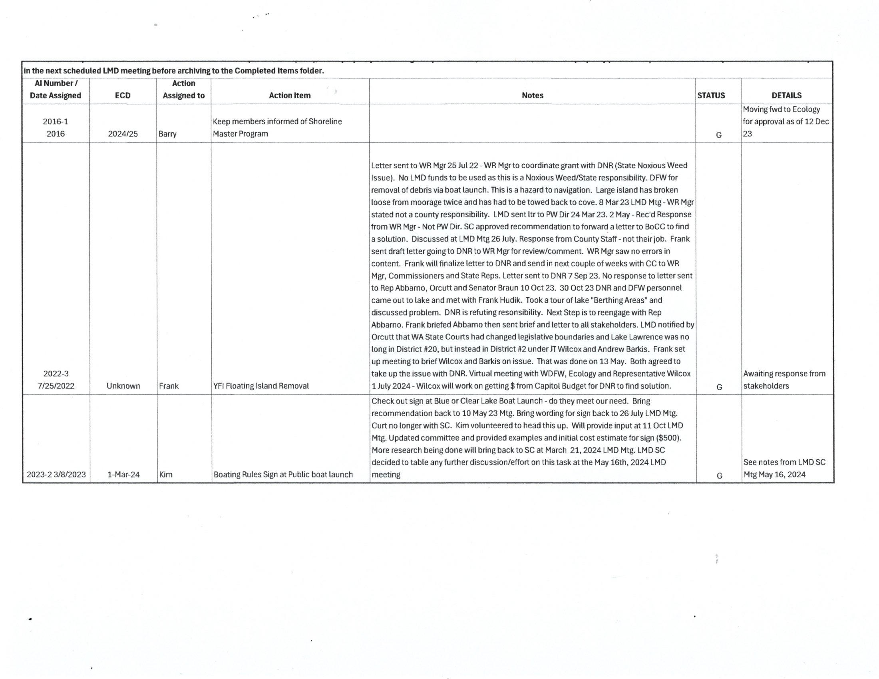
NO CHANGES SINCE LAST MEETING

Slide 30
2025 SC Meeting Schedule (6:30-8:30 p.m.):
2025/26 CMP Meeting Schedule:
Mtg#2 – Monday 5 May 2025 1-hour virtual w/SC 6:30-7:30 p.m.
Mtg#3 – Thursday 11 Dec 2025 2 hours virtual w/SC 6:30-8:30 p.m.
Mtg#4 – Thursday 17 Apr 2026 2 hours In-Person w/All LMD 6:30-8:30 p.m.
Mtg#5 – Thursday 11 Jun 2026 2 hours virtual w/SC 6:30-8:30 p.m.
2025 Survey Schedule – 9 a.m. (2-3 hours):
Annual Meeting – 7-9 p.m.
Thursday 20 February (Virtual) – LMD Renewal Work Session
Thursday 15 May (In Person)
Thursday 17 July (Virtual)
Thursday 16 Oct (In Person)
Saturday 19 Apr
Tuesday 13 May
Tuesday 10 June
Tuesday 24 June
Tuesday 8 July
Tuesday 19 August
Thursday 20 Mar (Virtual)
Thursday 25 September
Thursday 17 April Special Session (Virtual)
2025 LMD Meeting/CMP/
Survey Schedule

Slide 31
2026-2027 BUDGET & WORK PLAN
G
6 May 2025 emailed to SC Members for review/comment.
15 May 2025 reviewed/discussed at LMD Meeting.
17 July 2025 final review/discussion/approval at LMD meeting.
20 July 2025 forward to EH.
G
G
G = Green = Completed On Time
Y
Y = Yellow = Late – Program Jeopardized
R
R = Red = Mission Fail

Slide 32
GO TO WORD & EXCEL SPREADSHEET

Slide 33
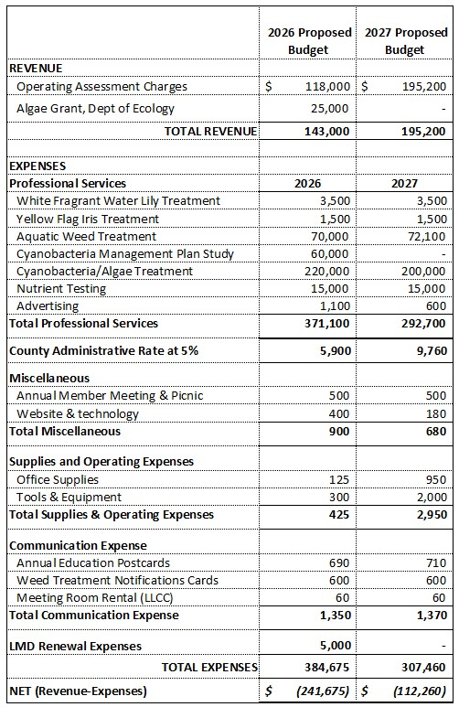

Slide 34
BUDGET & WORK PLAN 2026-2027
Motion to approve 2026-2027 Budget & Work Plan as amended and submit to Environmental Health.
YES_____ NO_____

Slide 35
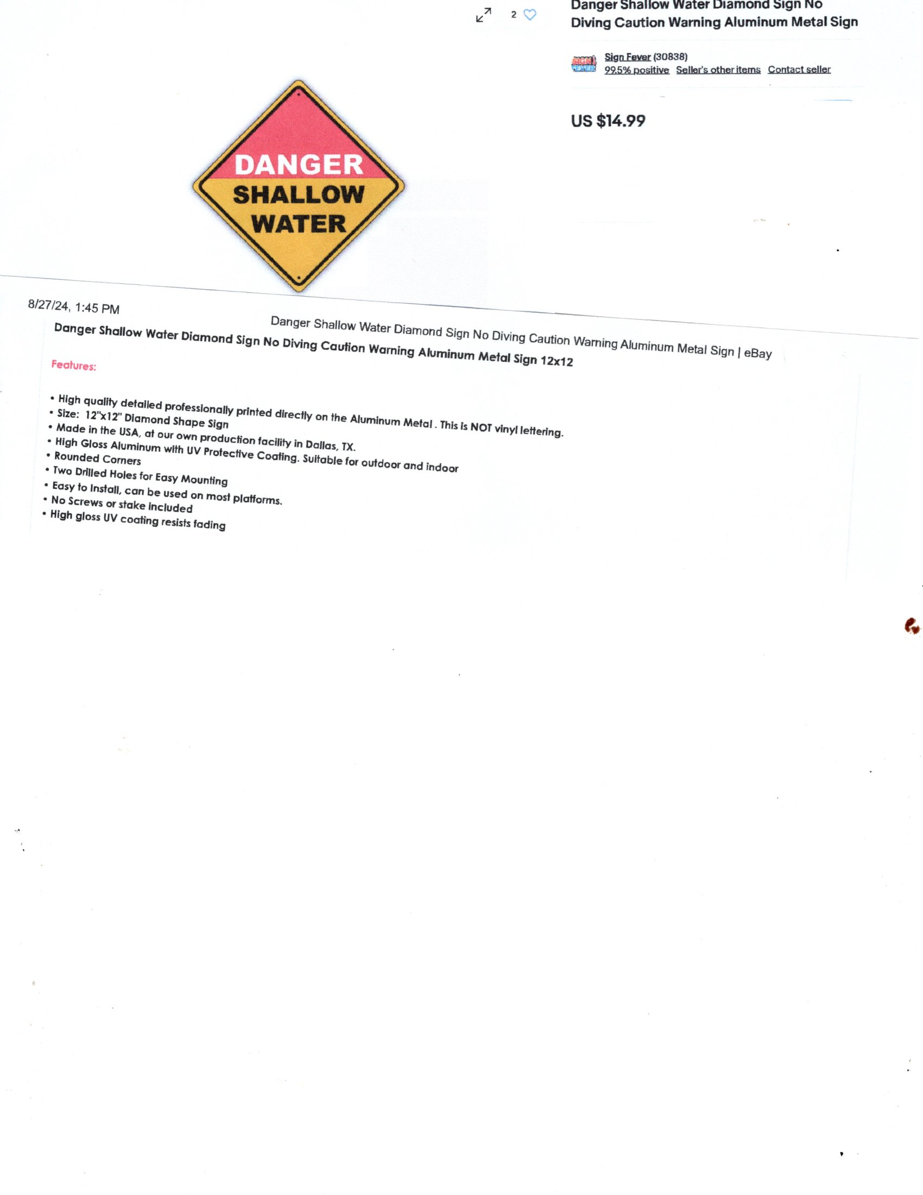
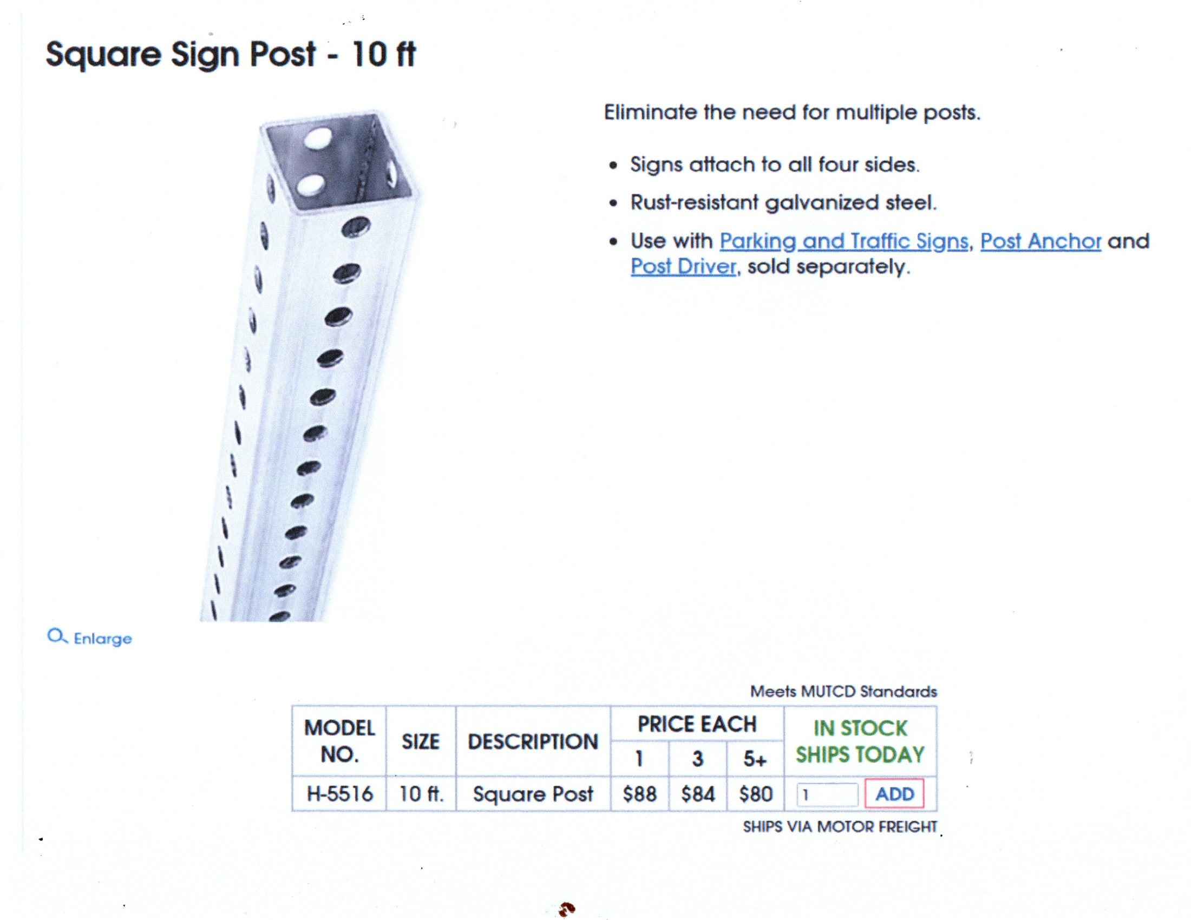
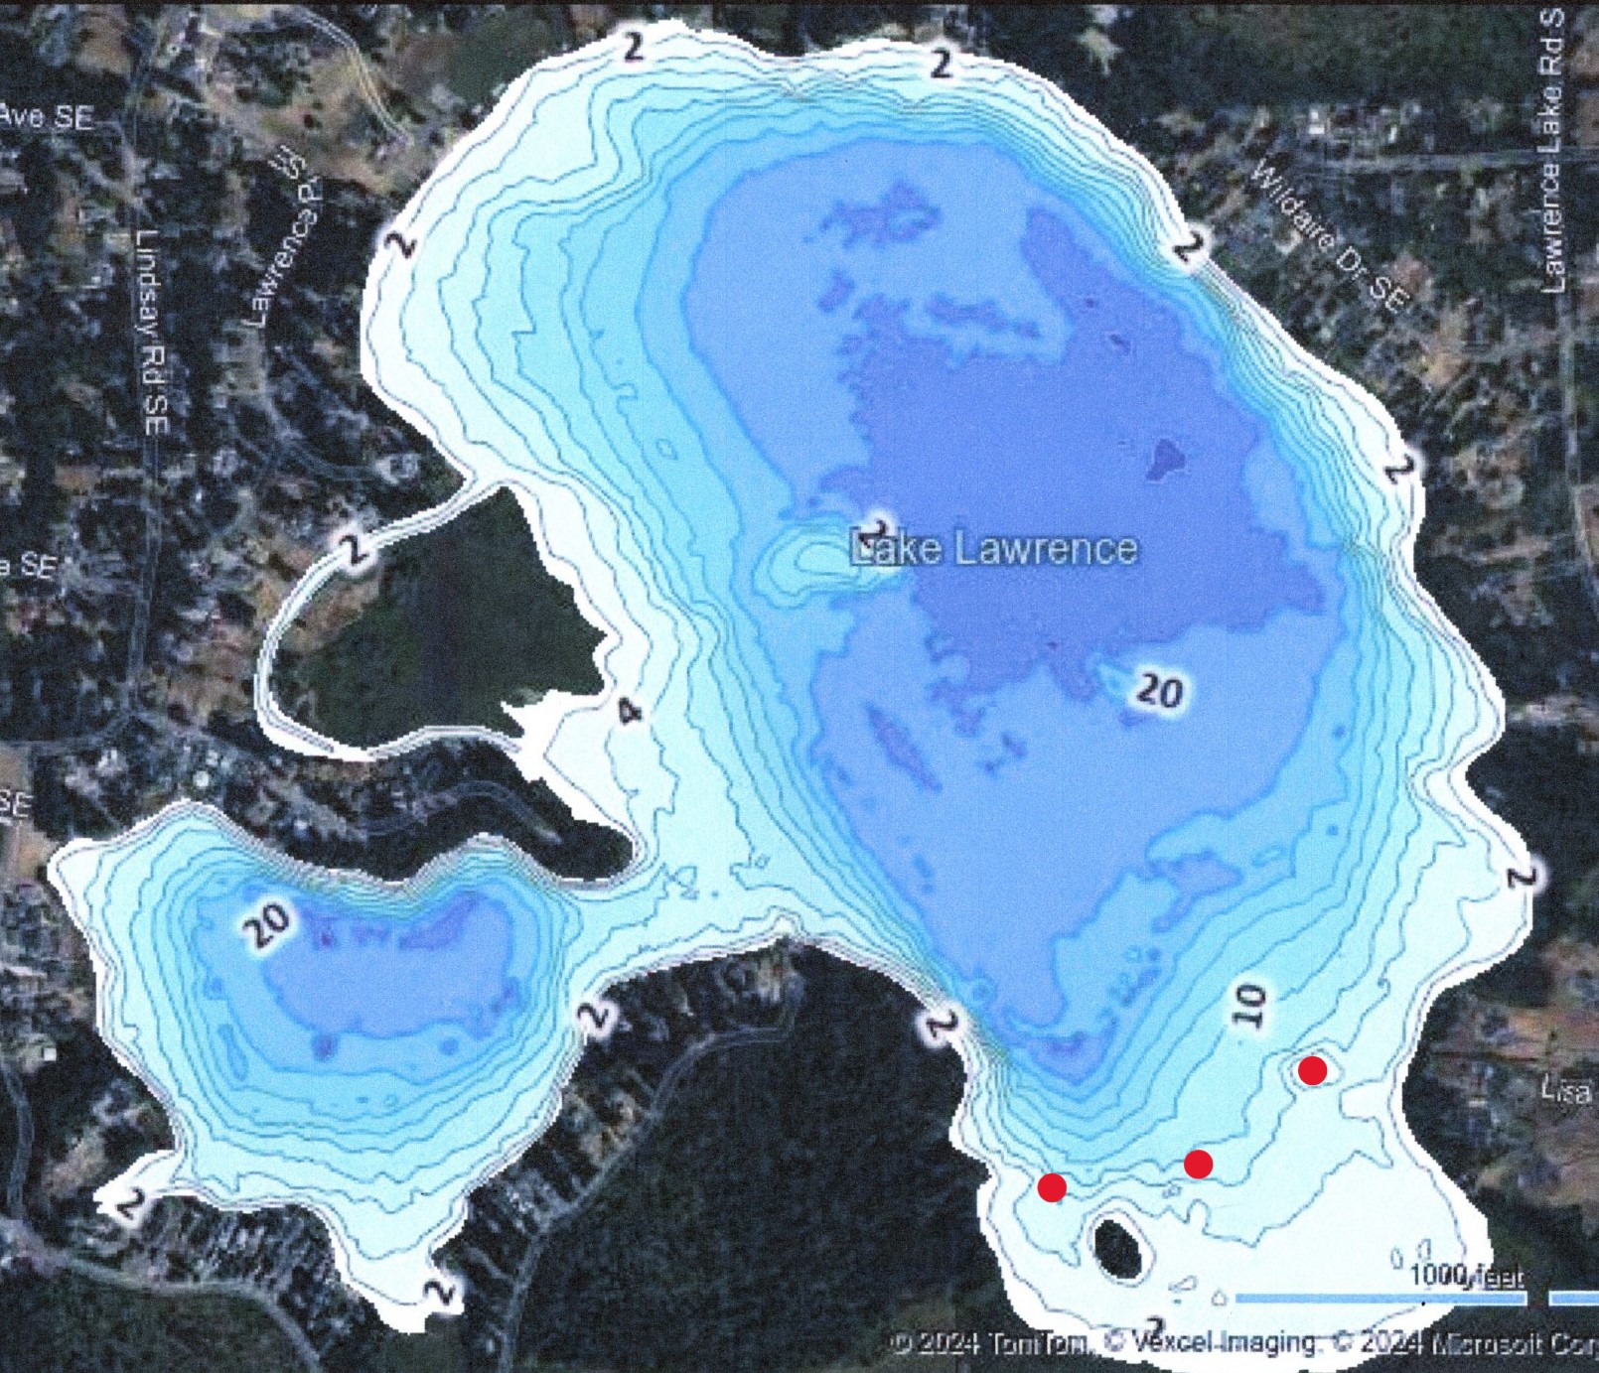
Recommendation:
April 2025 install 3 signs on steel stakes 100-150’ apart across the southern end of Lake Lawrence to warn boaters of extreme shallow water dangers.
Cost:
Signs – 3 x $20 = $60
10’ Square Sign Post – 3 x $84ea. +tax & Shipping = $100 ea.
Tamper Proof Bolts – 10 x $14+tax (Home Depot)
Tamper Proof Nuts – 10 x $12+tax (Home Depot)
80 lb Concrete – 3 x $6 + tax (Home Deport_
TOTAL: $404+tax +/- 10% APPROVE AT 17 OCT 24 LMD MTG
DNR/WDFW – No issues
County EH – ?
County Sheriff – Deputy Cady, Boating Enforcement Officer
– No legal issues as long as lake organization board approves.

Slide 36
NEW BUSINESS

Slide 37
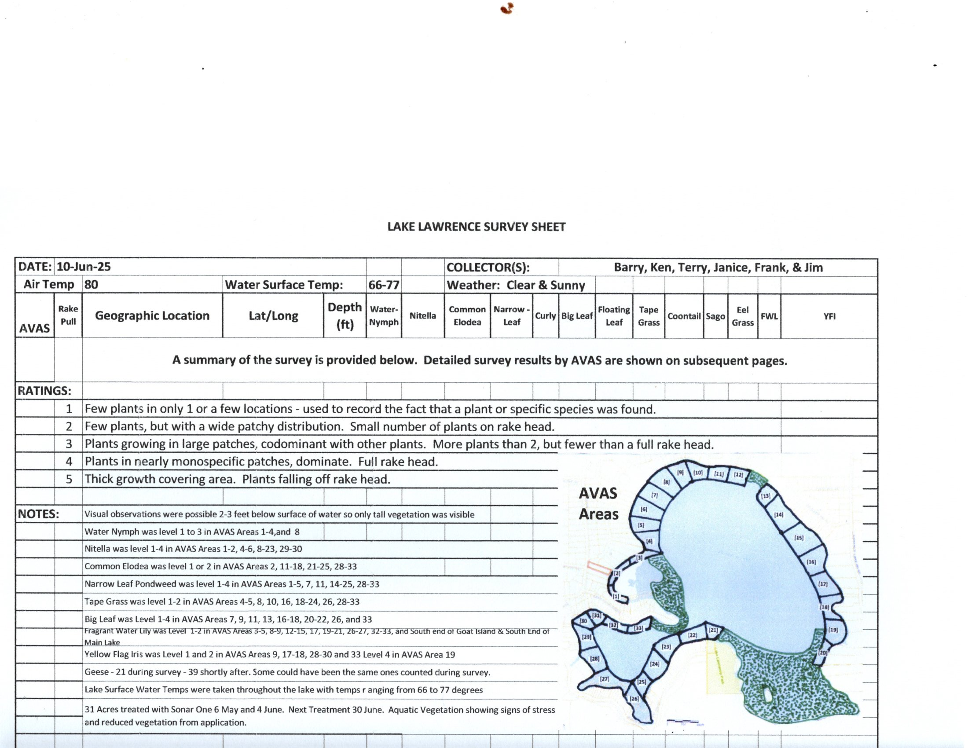
10 June LAKE SURVEY RESULTS
10 June LAKE SURVEY RESULTS

Slide 38
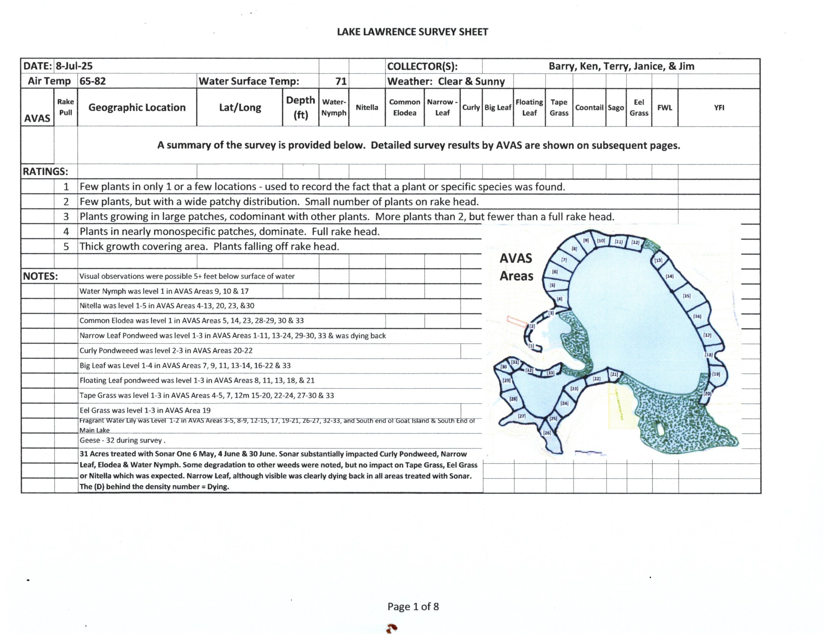
8 July LAKE SURVEY RESULTS

Slide 39
ANNUAL MEETING 25 SEP
Format
Agenda
Food – Deserts & Beverages
Cost

Slide 40
Other Business
Good of the Order
  Schedule Etrophix Presentation for March 2026 LMD Meeting (30 Minutes)
  A month ago Long Lake identified 5 Acres of Milfoil on their lake. Surveys are important.
  On 17 June I attended the BOCC meeting and provided 3 minutes of testimony on the status of our LMD Renewal. Long Lake still has not had their initial Public Hearing. Tuesday (15 Jul) BoCC scheduled it for 5 Aug.
  Next LMD Meeting we will be setting meeting dates for 2026, approving the State of Lake Lawrence Report & updating hand receipts for LMD weed rakes.
  2025 Fish Plants Lake Lawrence:
    13 February 2025 – 215 Rainbows @ 5.5 lbs. each
    20 February 2025 – 20k Rainbows @ 0.4 lbs each (8-10”)
    24 February 2025 - 230 Rainbows @6 lbs. each
    2 May 2025 – 5k Rainbows @ 0.4 lbs. each (8-10”)

