Slide 1



Zero Valent Iron Phosphate
Treatment
Patrick Randall, P.E.
Pat.Randall@Hepure.com
866.727.4776 x702
Notes:
Hi, my name is Pat Randall. I am a profession Civil Engineer in California. Today I will discuss how zero valent iron (ZVI) is used to treat phosphate in recreational lakes. Our primary market is in-situ treatment of chlorinated solvents at contaminated sites. We also support a lot of abandon mine water treatment project.
Please note this is pre-recorded. I will be glad to take question at the end.

Slide 2
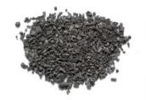
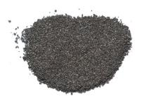
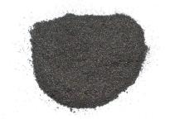
FEROX REMEDIATION GRADE ZVI POWDERS
Ferox PRB, Large particle size (325µ) for barrier applications
Ferox Flow, Smaller injectable particle size (125µ) for plume applications
Ferox Target, Smallest injectable particle size (40µ) for source area applications
Notes:
We provide three types of ZVI. All are the same chemistry only differ by average particle size. PRB is the most coarse, similar to construction sand. I is used in barriers or other applications where water will flow through. Flow is our primary ZVI product which combines reactivity with longevity. Flow is the finest and provide the most reactivity.
The next chart give you a comparison look at the three.

Slide 3
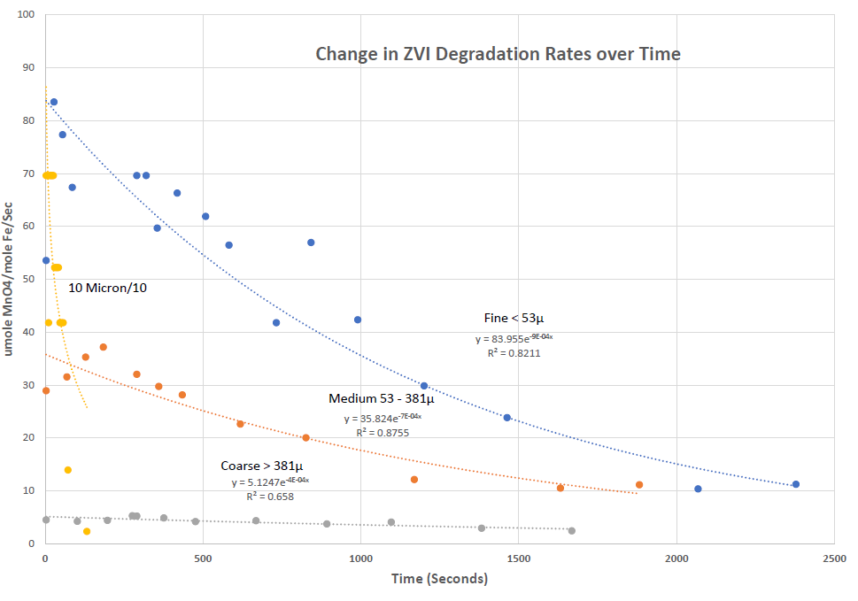
ZVI Reactivity by Particle Size
(Fu, Dionysiou, & Liu, 2014)
Notes:
This shows the difference in reactivity and longevity of the three different Hepure ZVI. I also show the short life of a 10 micron zvi which is becoming increasingly more popular due to the great reactivity. However, this is very short lived and really not suitable for most projects.

Slide 4
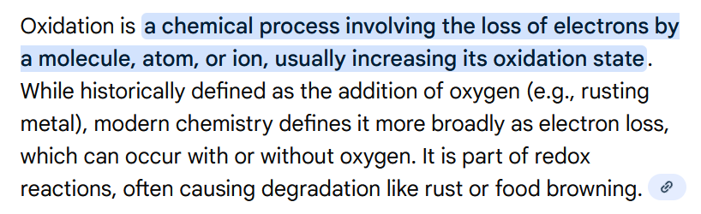
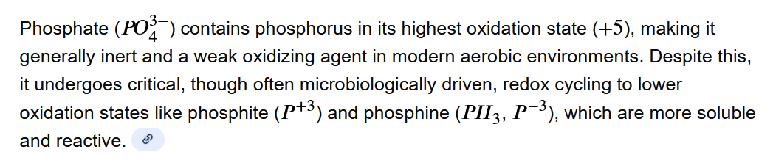
Oxidation – State of Phosphate
Notes:
I want to insure we are all discussing with the same terms. A bit confusing but oxidation is actually the loss of electrons. In the case of phosphate it is fully oxidized in the soluble form and cannot be further oxidized unless by a strong oxidizer such as an acid.

Slide 5
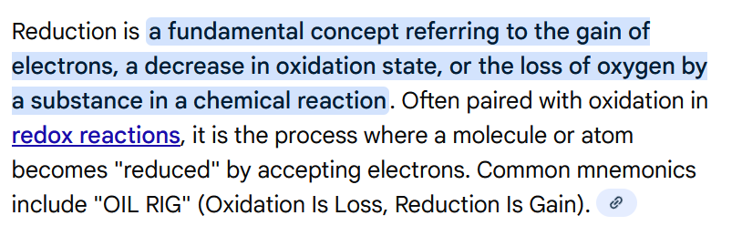
Reduction
Phosphate being fully oxidize must be reduced to a non-soluble form.
Notes:
This is the confusing part, reduction is actually the acceptance of electrons. Phosphate being fully oxidized is now ready to be reduced to the non-soluble form.

Slide 6
ZVI Oxidation & Ion Release:
Zero-valent iron (Fe0) corrodes (Oxidizes),
losing electrons and forming dissolved iron ions
(Fe2+) and (Fe3+).
Example (Simplified Aerobic):
Fe0→Fe2+ +2e-
followed by Fe2+ oxidation to Fe3+ 1e-
Iron oxidation releasing a total of 3 electrons
Notes:
The ZVI oxidized releasing up to three electrons which the phosphate is seeking. (actually would like to get 5 electrons)

Slide 7
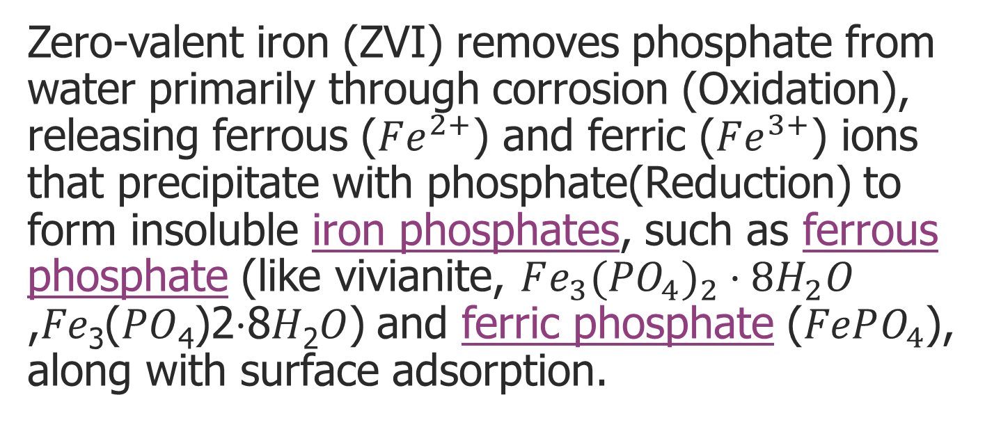
Phosphate Reduction-Precipitation:
Zero-valent iron (ZVI) removes phosphate from water primarily through corrosion (Oxidation), releasing ferrous ($Fe^{2+}$) and ferric ($Fe^{3+}$) ions that precipitate with phosphate(Reduction) to form insoluble iron phosphates, such as ferrous phosphate (like vivianite, $Fe_{3}(PO_{4})_{2}⋅8H_{2}O$ ,𝐹𝑒₃(𝑃𝑂₄)2⋅8𝐻₂𝑂) and ferric phosphate ($FePO_{4}$), along with surface adsorption.
Notes:
The phosphate is reduced by combining with the ZVI to form precipatates.

Slide 8
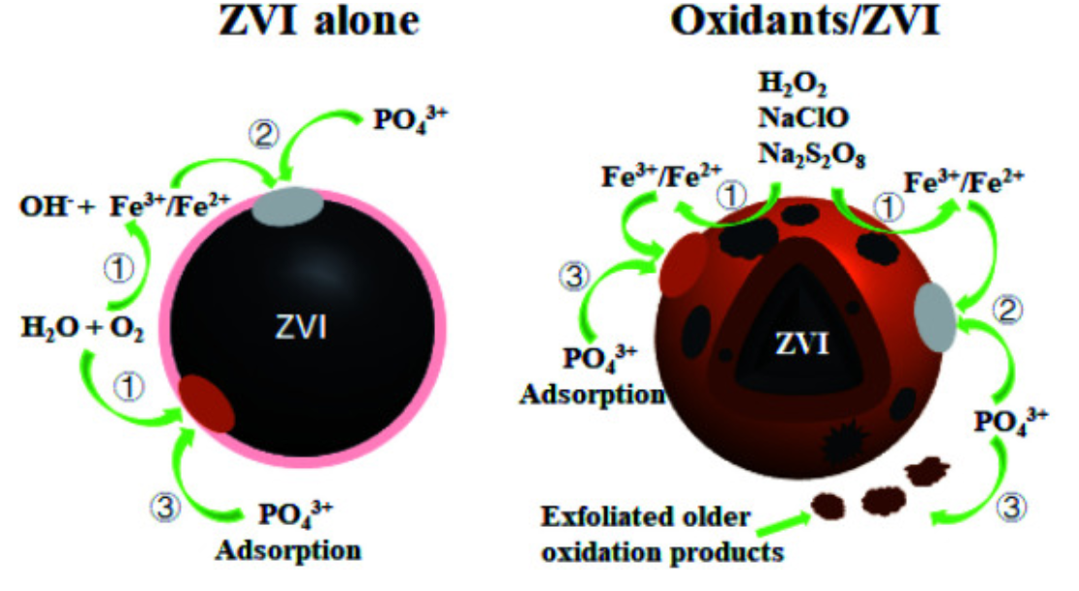
Anaerobic/Aerobic Phosphate Removal
(Fu, Dionysiou, & Liu, 2014)
Notes:
Although having and oxidant like oxygen present will help the reaction, it is not needed ZVI can oxidize without oxygen present and react with phosphate. The next diagram show this effect.

Slide 9
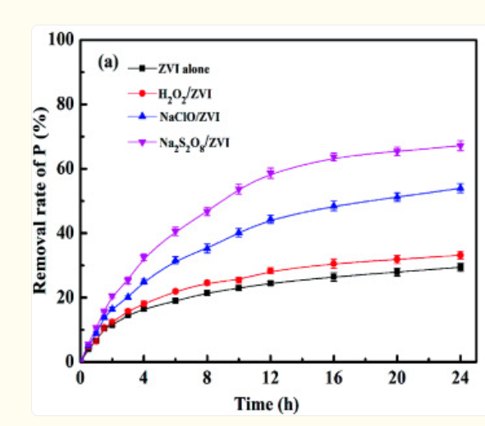
Phosphate Removal with/without Oxidation
(Fu, Dionysiou, & Liu, 2014)
Notes:
The removal rate of phosphate is not greatly effective by the addition of hydrogen peroxide, although it can be greatly effected by the addition of stronger oxidants.

Slide 10
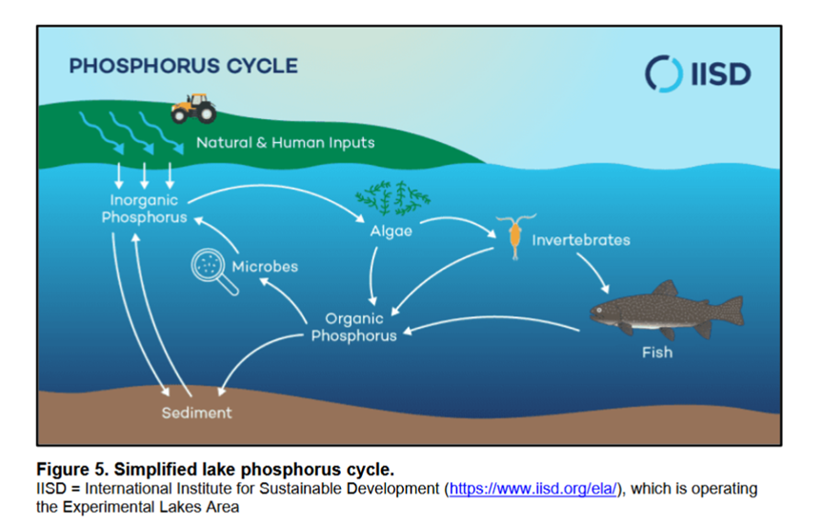
ZVI Phosphate Treatment
Surface Through Water Column
Run-on Prevention
Bottom Peculation
Within Sediment
Notes:
In lake treatment we are looking at four areas which ZVI can be used for treatment
Prevent run on from surfact waters
Apply on lake surface and reduce soluble phosphate in the lake prior to settling on the bottom.
Prevent phosphate which may be oxidize in the sediment from reaching the lake water
Act as a barrier for perculation of groundwater through the sediment to the lake water

Slide 11
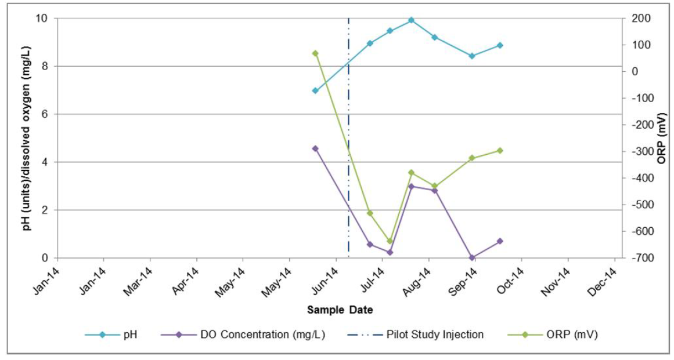
Effect of ZVI on DO and pH
Notes:
This chart shows the effect of ZVI on DO and pH after application, there is some effect on DO but DO does recover. pH increases but then recovers.

Slide 12
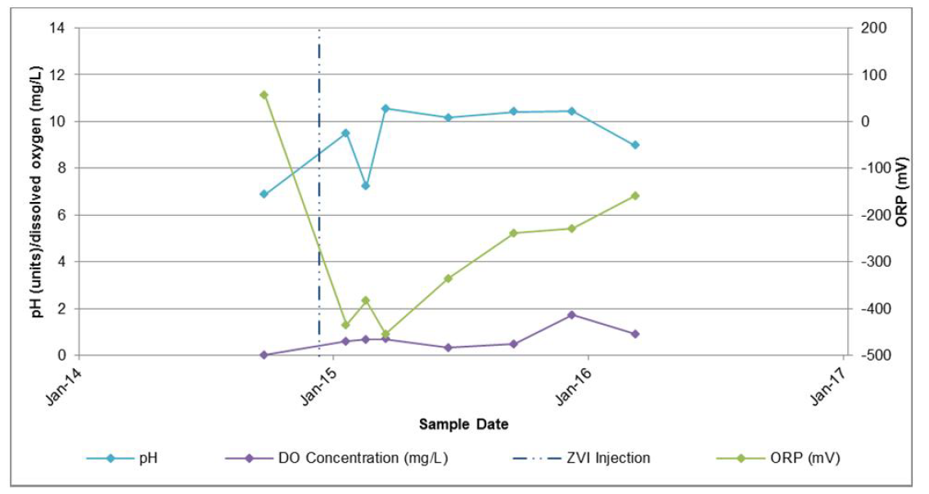
Effect of ZVI on DO and pH
Notes:
Same project ,, there is little effect on DO. pH increases but then recovers.

Slide 13
Lake Projects
Spanaway Wa
Clarity WI
Saulk MN
Don Russell
  Twin Lakes
  Joes Creek
  Lake Lorene
McLeese BC
Steila
Notes:
This is a list of lakes we have support in some manner in the last few years. I do not have data to show how these have done over time.

Slide 14
ZVI Phosphate Treatment
Surface Through Water Column
Run-on Prevention
Bottom Peculation
Within Sediment
Notes:
I will pause now to take questions. When the question are complete we will provide additional information of the specific application of ZVI for your project. Right now I would like to just go over the chemistry.

Slide 15
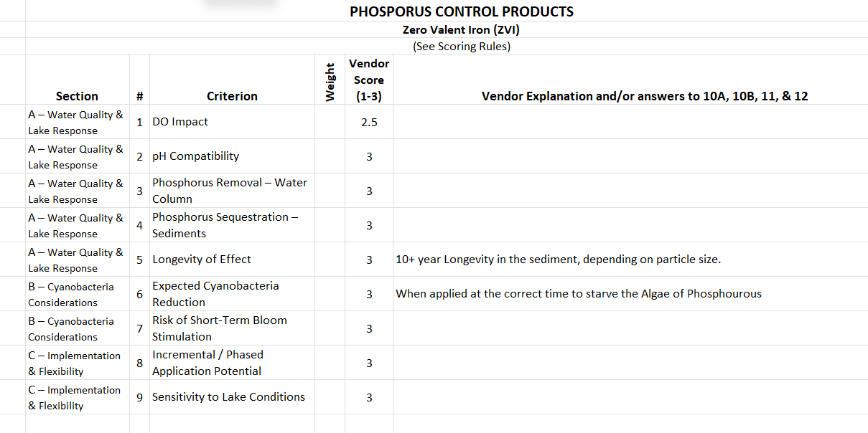

Slide 16
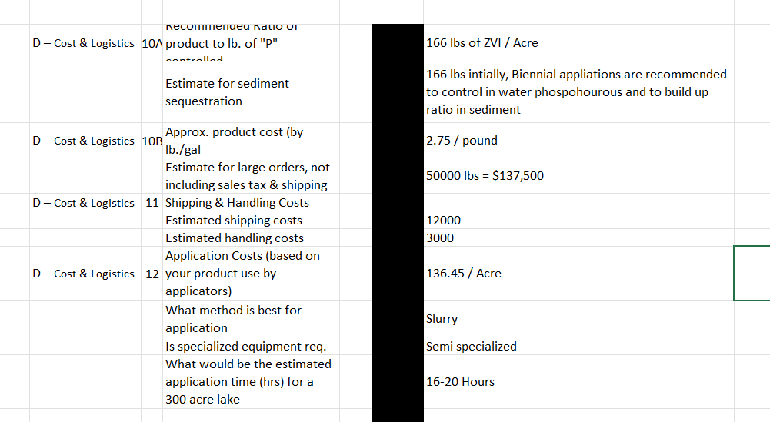

Slide 17
