Slide 1

Lake Lawrence Phosphorus Control Product Evaluation
Presented by Greg Wagner
Efficient, Holistic, and Sustainable

Slide 2

Lake Therapy
Efficient – Solving multiple problems with less products.
Holistic – Improving the health of your water by addressing the root cause rather than symptoms .
Sustainable– Solutions that promote long-term environmental balance that provide benefit for both people and the environment.

Slide 3
Lake Lawrence Context
Shallow Eutrophic Lake
    320 acres
    Max Depth 25 ft, Avg Depth 12 ft
Recurring cyanobacteria blooms
    Mostly Microsystin
Seasonal low dissolved oxygen conditions
    In Hypolimnion - below 2 and 5 mg/L
Primary source of phosphorus
    Sediment release
Hydraulic residence time: 2 to 4 years
Long-term goal: incremental, sustainable phosphorus reduction
East/Big Basin
Range: 23 – 130 μg/L
Annual Average: 58 μg/L
Feb-Mar Average: 38 μg/L
West/Small Basin
Range: 16 – 75 μg/L
Annual Average: 39 μg/L
Feb-Mar Average: 34 μg/L
Whole Lake
Range: 24 – 124 μg/L
Annual Average: 56 μg/L
Feb-Mar Average: 37 μg/L

Slide 4
Lake Lawrence Phosphorus Load
Calculations Total Lake
    Water Column – Average P of 56 μg/L y
      Yields 584 lb P
      This varies slightly from some of the historical data (Avg 70 μg/L)
    Sediment Data – Average P of 1142 mg P/kg
      Assuming 10% solids and 46% availability, Yields 16,468 lbs P
Predicated on the conditions described we are recommending SeDox Max as a solution for Lake Lawrence

Slide 5
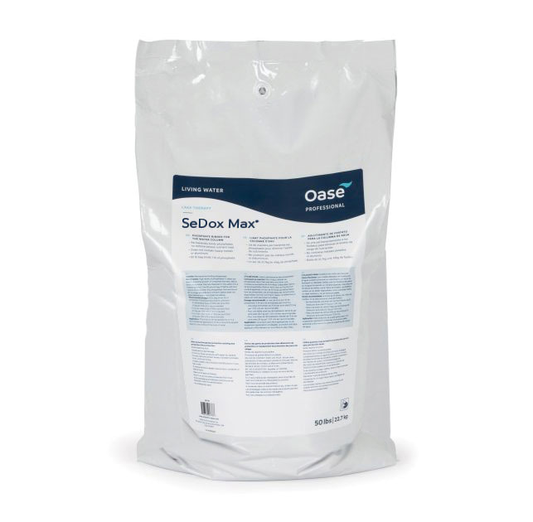

SeDox Max
Binds the orthophosphate in water into insoluble minerals apatite​ and rhabdophane
Long-term continuous phosphate binding​
Adds biologically available carbon species and thus optimizes the nutrient ratio (C:P)
Promotes microbial activity by releasing oxygen at the sediment, which allows higher N and C turnover rates
Feature | SeDox | SeDox Max
Phosphate binding | ✓ | ✓
Oxygen enrichment | ✓ | ✓
Inorganic carbon addition | ✓ | ✓
Nutrient ratio balancing | ✓ | ✓
Phosphorus binding capacity (g/P/kg) lbs per 50 lb bag) | 15 – 20 1 | 30 1.5

Slide 6
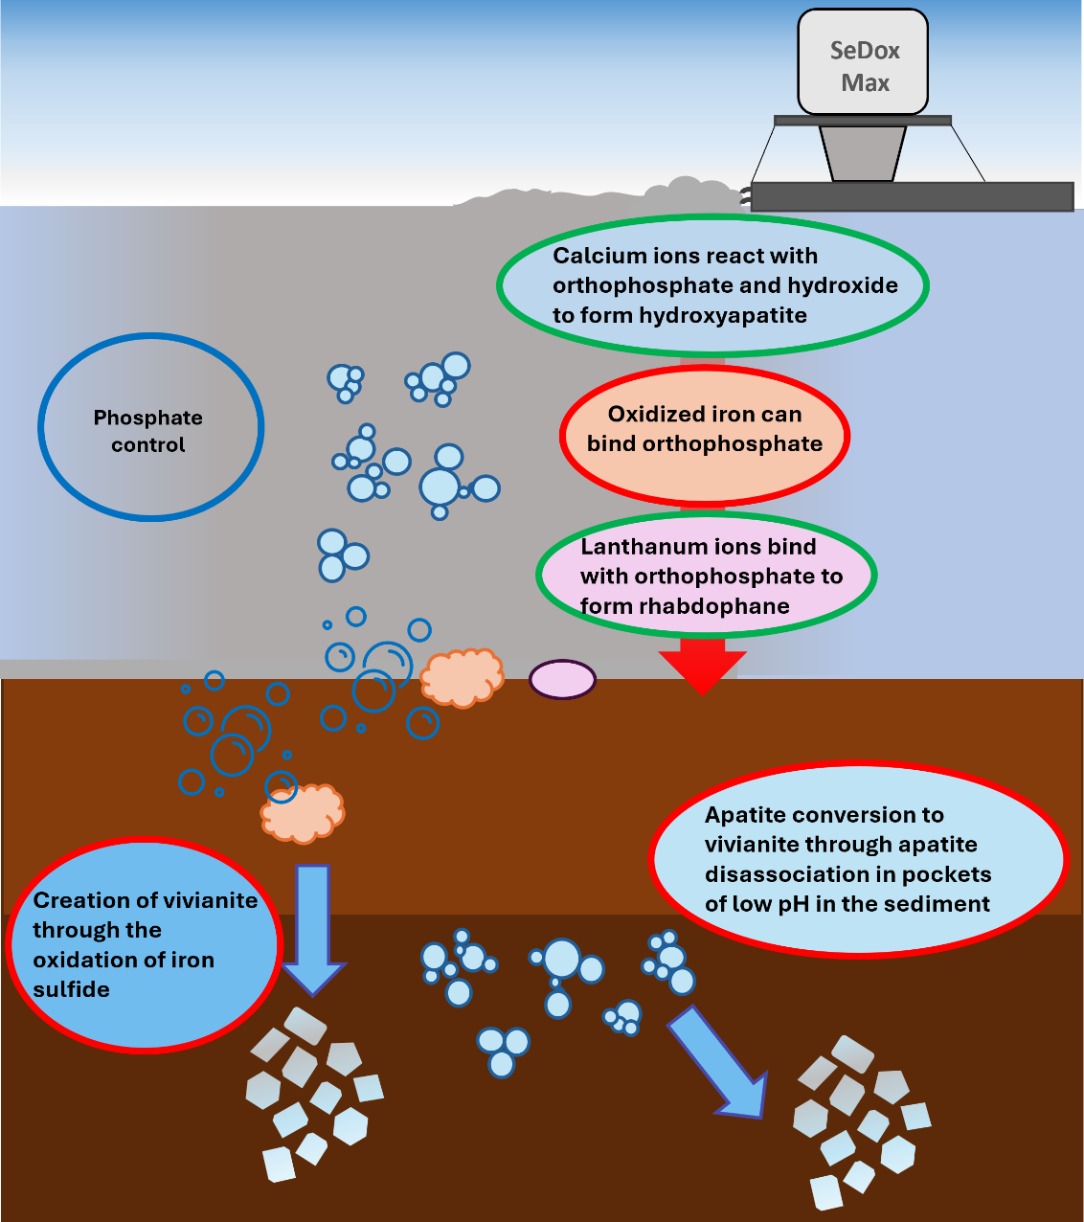
SeDox Max – Phosphate control
How does SeDox Max control phosphorus in treated water bodies?
The components in SeDox Max will bind with orthophosphate as it is applied to the water column through different P-binding processes
Lanthanum oxide enhances the formation of hydroxyapatite – Syngergy between the actives
-formation of hydroxyapatite
-formation of rhabdophane
-oxidation of Fe(II) to Fe(III)
-Fe(II) release via decoupling with sulphide (FeS dissolution) due to biological sulphide oxidation (CaO₂ driven) and direct vivianite formation
– conversion of apatite with Fe(II) to vivianite
What problems does this solve?
Binding orthophosphate prevents it being released into the water column
Less orthophosphate overtime can lead to improvements in the nitrogen cycle
Notes:
Calcium ions react with hydroxide and orthophosphate (which is released from the decomposition of organic matter by respiring bacteria) to for hydroxyapatite
Reducing bioavailable phosphorus and stabilizing the nitrogen cycle slowing and reversing the eutrophication process
Direct - reaction through the formation of hydroxyapatite (Ca ions binding with orthophosphate to form a mineral)
Direct – oxidation of Fe(II) to Fe(III) in the upper sediment layer
Indirect – Fe(II) release via decoupling with sulphide (FeS dissolution) due to biological sulphide oxidation (CaO₂ driven) and direct vivianite formation
Indirect – conversion of apatite with Fe(II) to vivianite
Indirect – providing suitable conditions for cable bacteria to allow electron transfer deeper into the sediment layers
Why is nutrient control important?
Binding orthophosphate prevents it being released into the water column to be used by algae – preventing subsequent blooms. Less orthophosphate overtime can lead to improvements in the N-cycle

Slide 7
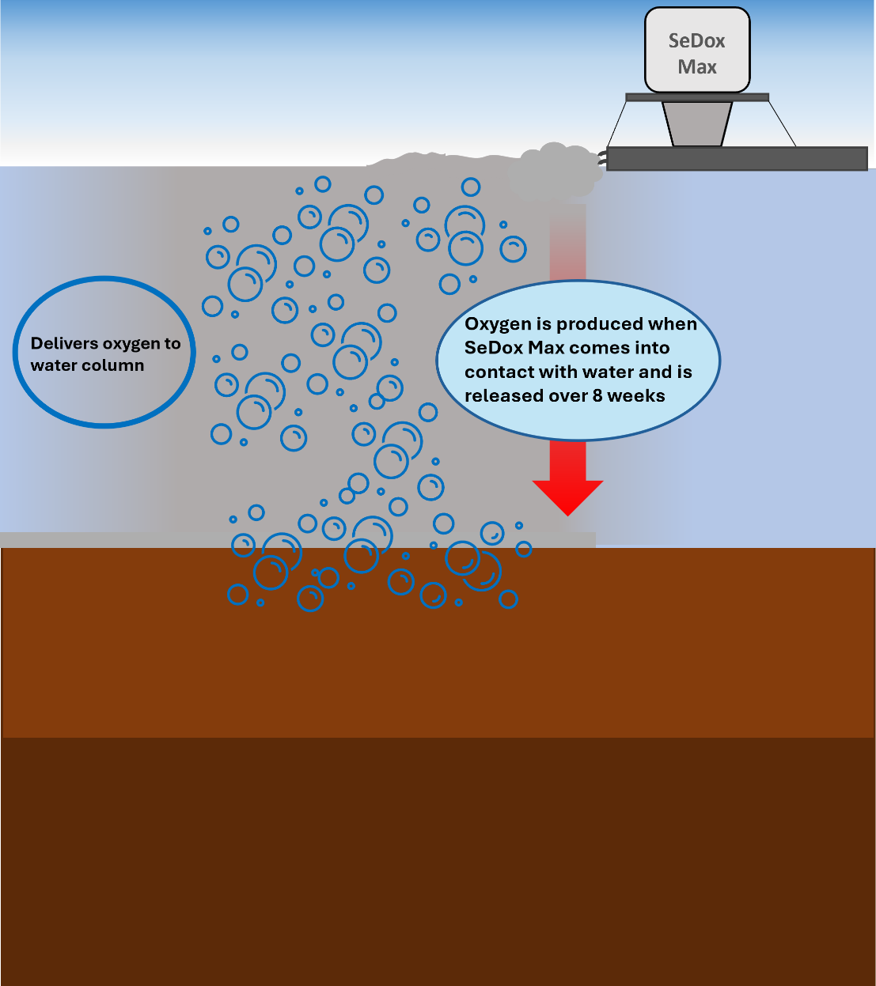
SeDox Max– Improve oxygen concentrations
How does SeDox Max add oxygen to treated water bodies?
Active component: calcium peroxide, when in contact with water, disassociates to release oxygen.
Molecular oxygen is released at the sediment water interface which oxygenates the upper sediment layer.
What problems does this solve?
Allows for more effective degradation of organic matter
Increases phosphorus binding capacity in the sediments
Aids decomposition of foul odors and organic substances
Prevents fish kills
Notes:
Why is delivery of oxygen important in the process?
Allows aerobic bacteria to dominate and degrade the organic materials more effectively than under anaerobic conditions

Slide 8
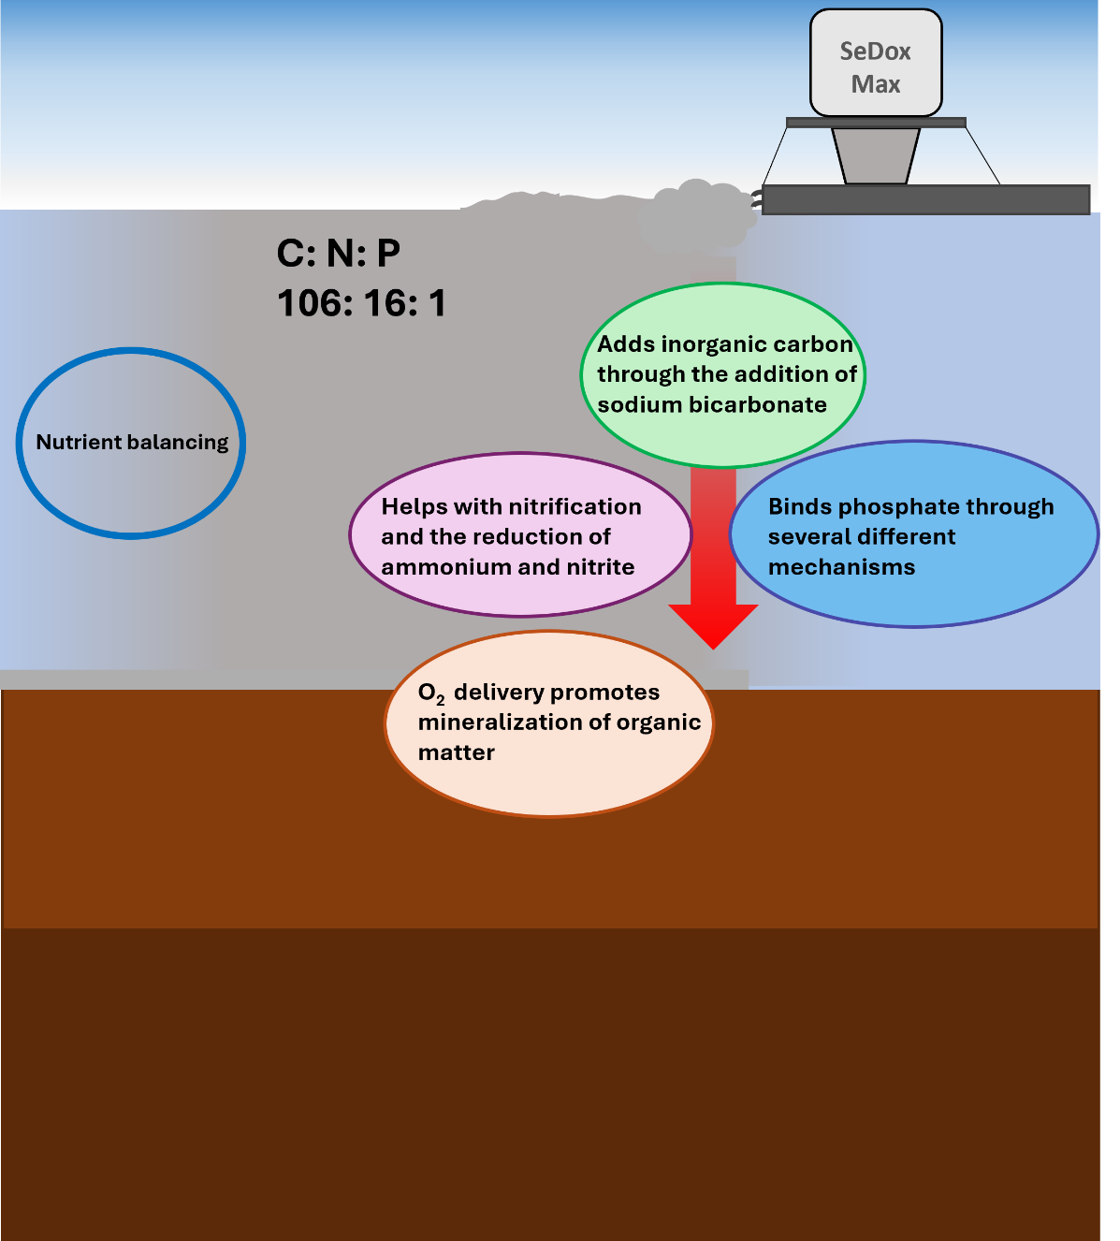
SeDox Max – Nutrient balancing
How does SeDox Max balance nutrients in treated water bodies?
The addition of inorganic carbon species helps to balance the pH. Increases the buffering capacity of the water and of the sediment
Binding of phosphate through mineral formation
Molecular oxygen release helps with nitrification – reducing ammonium and nitrite
Molecular oxygen release and buffering sediment pH – enhances aerobic microbial activity - enhanced mineralization of organic matter
What problems does this solve?
More stable waterbody – more resistant to changes in pH which is more supportive to aquatic life
Optimizing the C: N: P ratio aids more favourable conditions for biodiversity

Slide 9
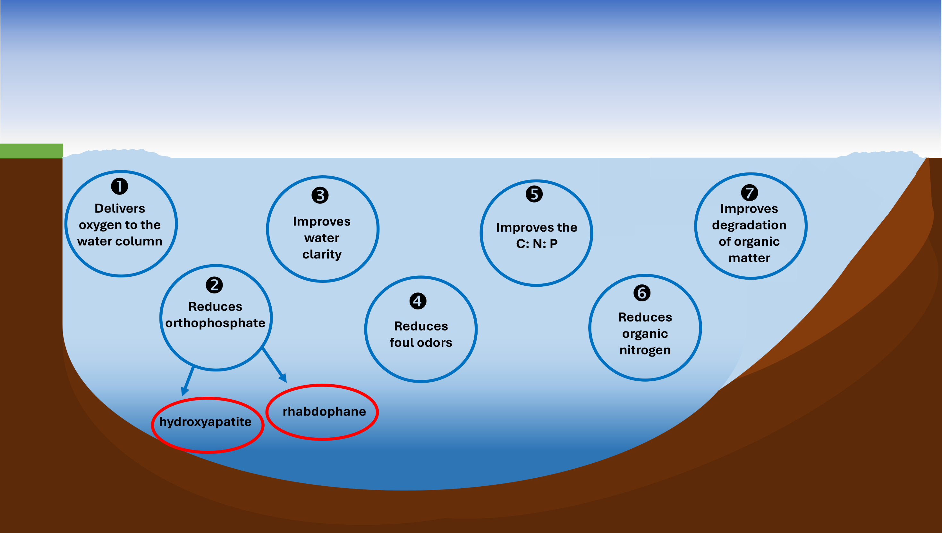
SeDox Max Benefits – direct and indirect

Slide 10
Phosphorus Control Product Evaluation

Slide 11
Section A: Water Quality and Lake Response
Dissolved Oxygen Impact
SeDox Max should be a net positive to DO due to product O₂ release
pH Compatibility
SeDox Max contributes alkalinity to the water to help improve buffering capacity
Phosphorus Removal – Water Column
SeDox Max will remove phosphorus from the water column
Phosphorus Sequestration – Sediment
SeDox Max will bind phosphorus at the sediment layer via multiple mechanisms
Longetivity of Effect
SeDox Max binds phosphorus as both hydroxyapatite and rhabdophane, permanently binding it into mineral form

Slide 12
Section B: Cyanobacteria Considerations
SeDox Max as discussed is a highly effective and efficient phosphorus binding program
Numerous papers have been published about the effectiveness of utilizing phosphorus mitigation as well as overall nutrient pollution control in efforts to mitigate Cyanobacteria blooms
Nothing about SeDox Max chemistry would indicate a risk for short term bloom stimulation

Slide 13
Section C: Implementation and Flexibility
Option 1: Complete Lake Reset
All product for water column and sediment added as one project
Significant mitigation at one time, also significant one-time cost
Option 2: Annual Treatments
Larger dosages on an annual basis
Spreads costs over years
Allows for testing and (re)evaluation
Additional benefits of oxygenation and alkalinity addition realized multiple times
Option 3: Maintenance Treatments
On going (Monthly) program management dosages
Better for smaller bodies of water, size of lake is not conducive

Slide 14

Section C: Implementation and Flexibility (cont)
Sensitivity to Lake Conditions
    SeDox Max is formulated to perform in a variety of lake conditions
      Solid State chemistry – work is done on surface of particles
      Conditions are created for on nano scale for reactions
      Provides alkalinity and oxygen
      Works via multiple mechanisms

Slide 15
Section D: Cost and Logistics
Recommended Ration per pound of P controlled
SeDox Max requires 33 lbs of product to mitigate 1 lb of phosphorus
Approximate Product Cost (per pound)
We sell SeDox Max through distribution, in this case 2M. The final price per pound of product will be determined by how the product is purchased (directly, or through the applicator). We would anticipate product costs to be between $1.8MM and $2.2MM for complete P remediation based on approximately 17,000 lbs of P removed.
Shipping and Handling Costs
The shipping costs for this project will be handled by Oase
Any additional handling costs will be at the discretion of the applicator
Application Costs
Application of this product as a slurry will provide the most efficient and effective results
In a project of this size………large boat with significant slurry systems are required
Application Costs for a project of this size should be directed to the applicator chosen. Predicated on number of boats, available man-power, knowledge of the lake, etc.

Slide 16
Section E: Monitoring and Regulatory
Use of SeDox Max REQUIRES no additional analytical testing
Most customers choose to do some testing for verification of efficacy
Use of SeDox Max will require that Oase work with the state of Washington to develop an Experimental Phosphorus Sequestration Product Use Plan in accordance with the Washington State Aquatic Plant and Algae Management General Permit (APAM).
All fees associated with this work will be absorbed by Oase
It is our understanding that this work will require a certain amount of analytical testing. That testing will be done as part of the E.P.S.P.U.P and will be shared with Lake Lawrence.

Slide 17
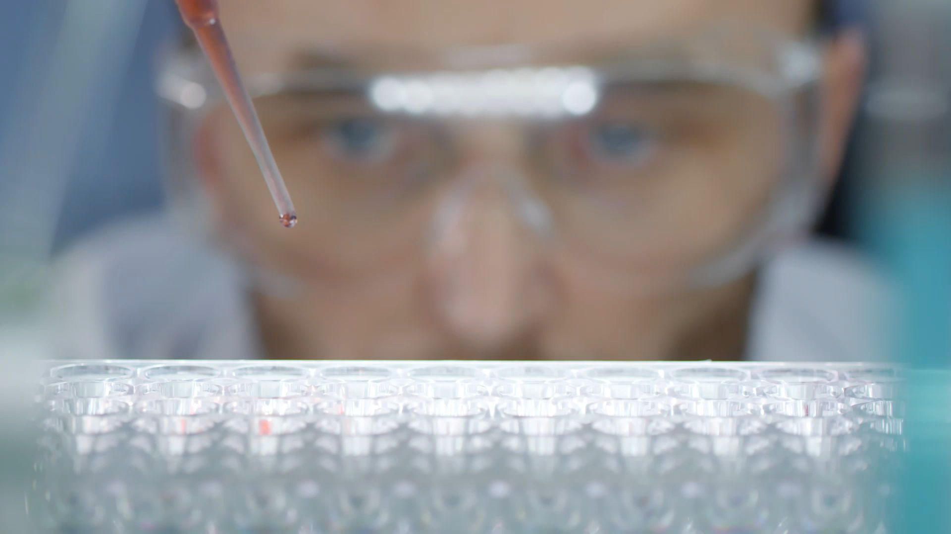
Section F: Ecology and Human Safety
As SeDox Max is a mineral based chemistry, toxicological effects are extremely low. An SDS with all prevalent toxicological information can be provided.
This product is considered non-hazardous to humans in the water.
Care should be taken during application to wear appropriate PPE per the SDS.

Slide 18
How We Are Different
Product | Improves Nitrogen Cycle | Buffers pH | Increases DO
LMB | ❌ | ❌ | ❌
Alum | ❌ | ❌ | ❌
SeDox Max | ✅ | ✅ | ✅
SeDox Max is designed to make the body of water healthier through improved water quality.

Slide 19

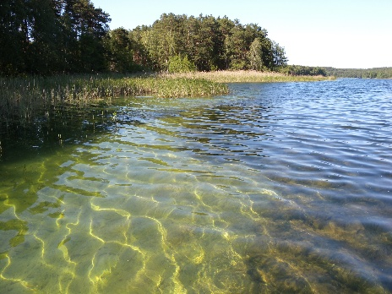

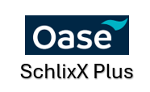

SeDox Max
Phosphate binding
Source: www.umweltbundesamt.de
Source: www.videvo.net
Increase oxygen concentrations
Water Chemistry balancing

Slide 20
Thank You!
Q&A
Much more info on our website below:
Professional Lake Therapy & Pond Management Solutions

